Slide 1
Jazz chant
Notes:
We’re going to do a Jazz Chant.
What’s Jazz? (Students: music).
What makes jazz different than other types?
(The rhythm).
What is a chant
(half singing/ half speaking)

Slide 2
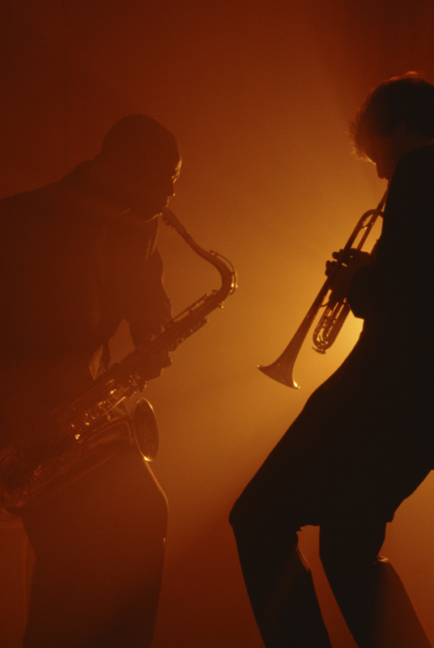
Jazz chant
Jazz chant
Notes:
Teacher: Yeah. What makes jazz special? What makes is different than rock or classical or other kinds of music?
(Students: the rhythm).
Right. And what’s a chant.)

Slide 3
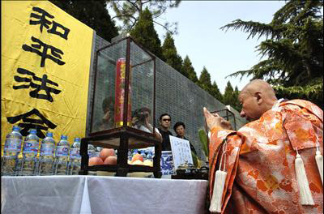
Jazz chant
Jazz chant
Notes:
A chant is half-way between speaking and singing.
You might hear chants at a shrine, a temple, a church or a mosque.

Slide 4
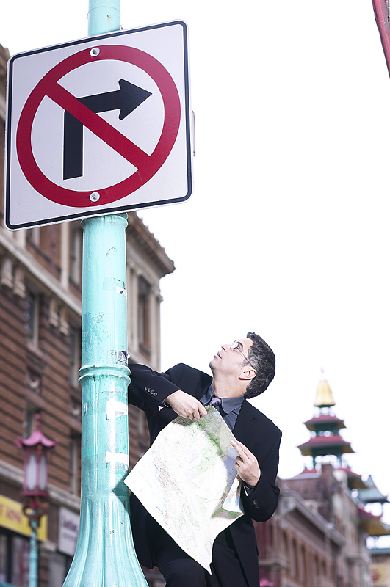
Where’s
the
bank?
Notes:
Teacher: This chant is “Where’s the bank”

Slide 5
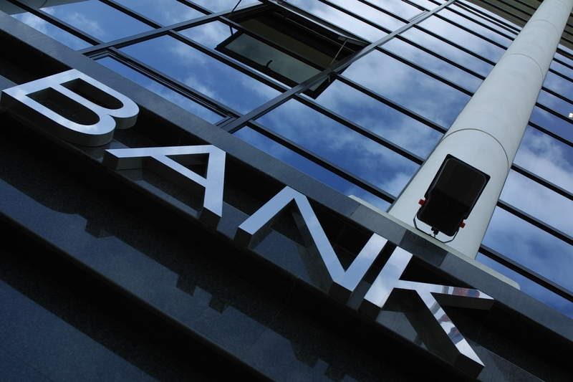
Excuse me.
Where’s the bank?
Notes:
Note to teacher: Have students snap fingers, clap or tap their desks in rhythm as you demonstrate the chant.

Slide 6
Excuse me.
Where’s the bank?
Go down this street to the corner
and then turn right.
Go down that street
to Main Street,
and then turn left.
When you get to the park,
you’ll see it on your right.
Notes:
Have them practice several times. To keep things interesting, use some of these variations:
• Half the class is A (the person asking). The other half is B.
Everyone practices together.
• Students practice in pairs, A and B.
• Everyone gestures with their hands on “left” and “right”

Slide 7
Did you say…
I go down this street to the corner
and then turn right.
I go down that street
to Main Street,
and then turn left.
When I get to the park,
I’ll see it on my left?

Slide 8
Right.
        •Left?
No, right!
        •Not left?
Go right!
        •Oh, right!
YEAH!

Slide 9
        ?
Notes:
After they’ve done it a few times, use the “pictures only” (no words) section of the slide show as cues. Students are often surprised at how quickly the can do the chant without reading the words.
Teacher: What’s this slide mean? (Students: Excuse me. Where’s the bank.).

Slide 10

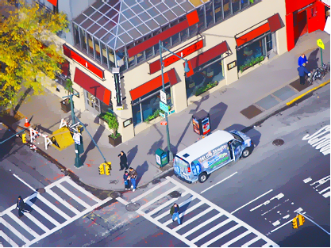


Slide 11
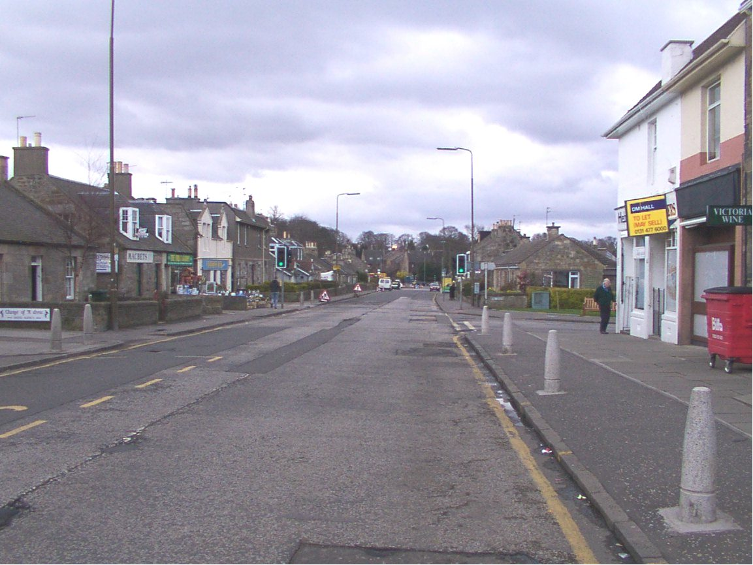

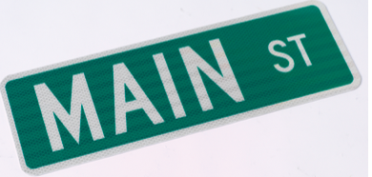


Slide 12
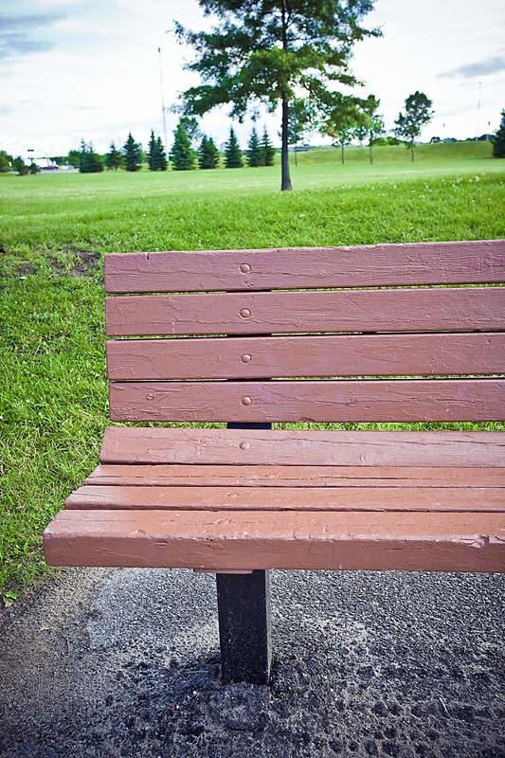
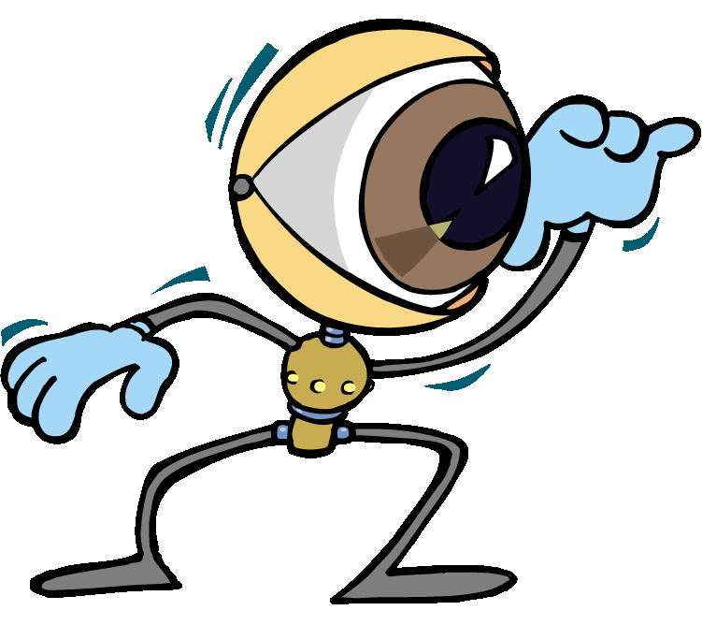

Slide 13

?

Slide 16
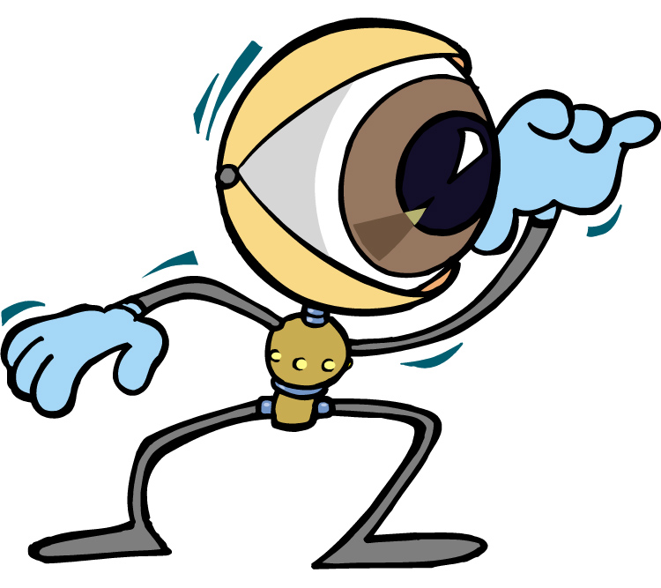

Slide 17
Notes:
Right Left?
No, right Not left?
Go right. Oh right!
Yeah!

Slide 19
Unit 4
Unit 5
https://www.pearson.co.jp/en/ef/

