Slide 1
Energy breaks
Human beings were not designed to sit in desks all day. Energy breaks are a series of short, physical activities you can use to get your students moving and energized. They are designed for EFL/ESL
Students so some language and concepts are simplified.
This features an Exercise Routine by Dr. Wendy Suzuki, a neuroscientist at New York University. It is from a TED Women 2107 (Nov. 2017) . In her book Healthy Brain, Happy Life, she calls this combination exercise and rhythmic speaking an “IntenSati.” “Inten” for “intention.” “Sati” is a Pali (a language from India) word for “awareness or mindfulness.” The “brain bite” science information is from that book. 2015. New York: HarperCollins.
These entire (13:04) TED talk is at:
https://www.ted.com/talks/wendy_suzuki_the_brain_changing_benefits_of_exercise
The TED Talk is used under Creative Commons liscence.
This powerpoint (except the TED talk excerpt) © Marc Helgesen. May be freely used for non-commercial purposes.
For more, visit: www.HelgesenHandouts.weebly.com. Click on “Physical activity…”
This slide is for the teacher’s information. The student slide show starts with slide 2.

Slide 2
Energy break

Slide 3
This is
Wendy Suzuki, PhD
Neuroscientist
New York
University

Slide 4
Watch.
Do what she does.
Repeat what
she says.

Slide 5
https://www.ted.com/talks/wendy_suzuki_the_brain_changing_benefits_of_exercise
From 11:15
Notes:
11:41

Slide 6
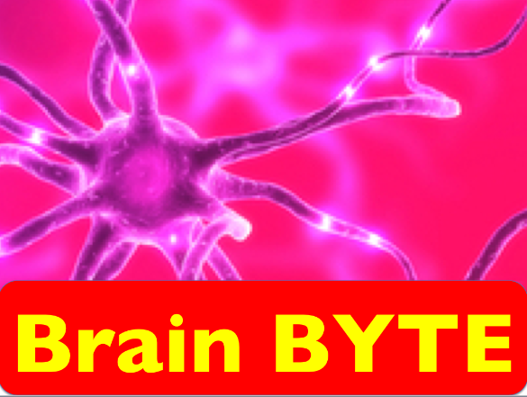
Why is exercise
so important?
A single workout…

Slide 7
Single workout:
Improves your
reaction time
:Reference

Slide 8
Single workout:
Increases your ability
to pay attention.
:Reference

Slide 9
Single workout:
Increases brain chemicals*:
Dopamine (memory
& motivation)
Serotonin (memory)
Noradrenaline
(better mood)
Neurotransmitters
& hormones
:Reference

Slide 10
Long-term workouts:
Increase attention
& positive mood
Reference:
Notes:
3-4 times a week. 30 min. Includes aerobic

Slide 11
Long-term workouts:
Give you a
better memory
Reference:
Notes:
3-4 times a week. 30 min. Includes aerobic

Slide 12
Long-term workouts:
Protect your brain
from aging &
memory loss
Reference:
Notes:
3-4 times a week. 30 min. Includes aerobic

Slide 13
Now that you
know why,
let’s do it
again!

Slide 14
https://www.ted.com/talks/wendy_suzuki_the_brain_changing_benefits_of_exercise
From 11:15
Notes:
11:41

Slide 15
Let’s
move!

Slide 16
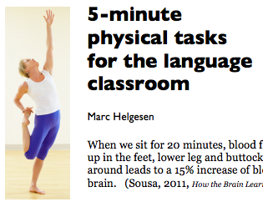
More ideas at
http://tinyurl.com/ELT-physical

