Slide 1
Energy breaks
Human beings were not designed to sit in desks all day. Energy breaks are a series of short, physical activities you can use to get your students moving and energized.
TaiChi is an exercise activity.
This one introduces Tai Chi and practices about 1-minute.
Tai Chi #2 and #3 each do another minute.
Tai Chi 5-minute routine does a complete routine.
References are on the last slide.
Thanks to Satsuki McNeill for suggesting this.
© Marc Helgesen. May be freely used for non-commercial purposes.
For more, visit: www.HelgesenHandouts.weebly.com. Click on “Physical activity…”
This slide is for the teacher’s information. The student slide show starts with slide 2.

Slide 2
Energy break

Slide 3
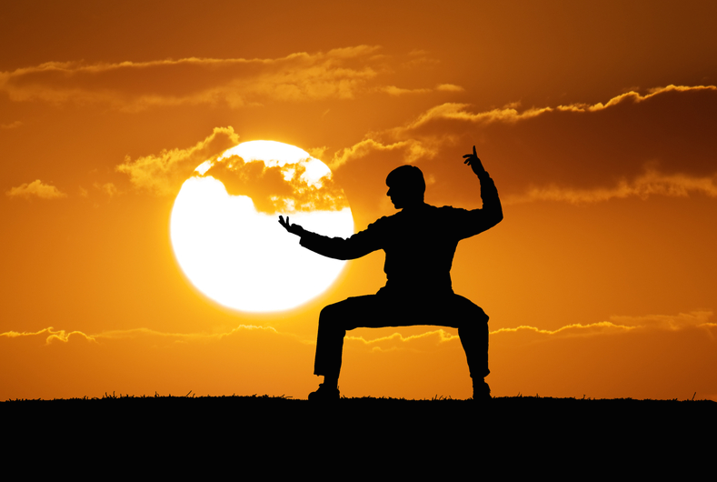
Tai Chi #1
Introduction

Slide 4
Tai Chi Introduction
Presenter: Leia Cohen

Slide 5
says
Tai chi
may
improve
brain
health
Referencing

Slide 6
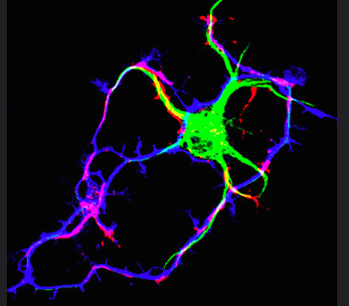
says
Tai chi
may
promote
neuro-
plasticity
Referencing
Art: journal of
Cell Biology

Slide 7
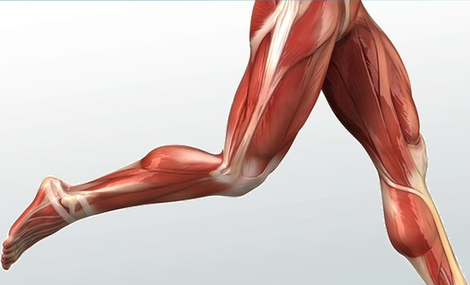
says
Tai chi
speeds up
muscle
recovery
Art: Study.com
Referencing

Slide 8
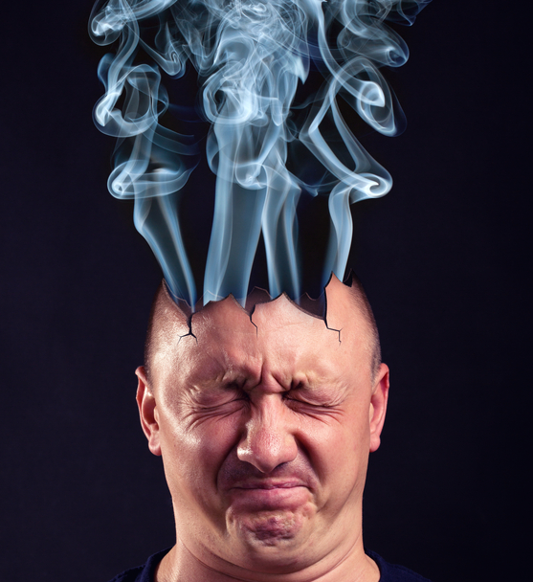
says
Tai chi
reduces
stress &
anxiety
Referencing

Slide 9
Let’s try! -1 minute

Slide 10
Full video:
Tai Chi 5 minutes a day Module 01
https://www.youtube.com/watch?v=cEOS2zoyQw4&t=411s
Psychology reference:
Wei, M. (4/24/2018) Tai Chi May
Improve Brain Health and Muscle
Recovery. Psychologytoday.com
Thanks to Satsuki McNeill for
suggesting this.

Slide 11
Let’s move!

Slide 12
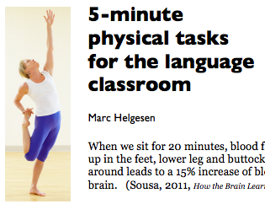
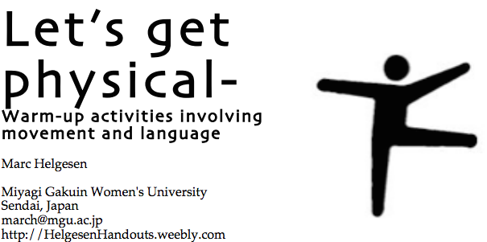
More ideas at
http://tinyurl.com/ELT-physical

