Slide 1
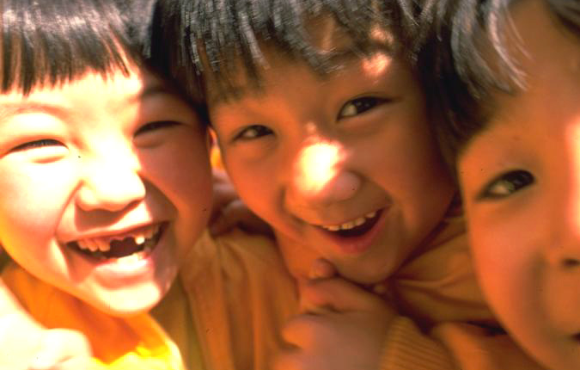
Storytelling with kids

Slide 2
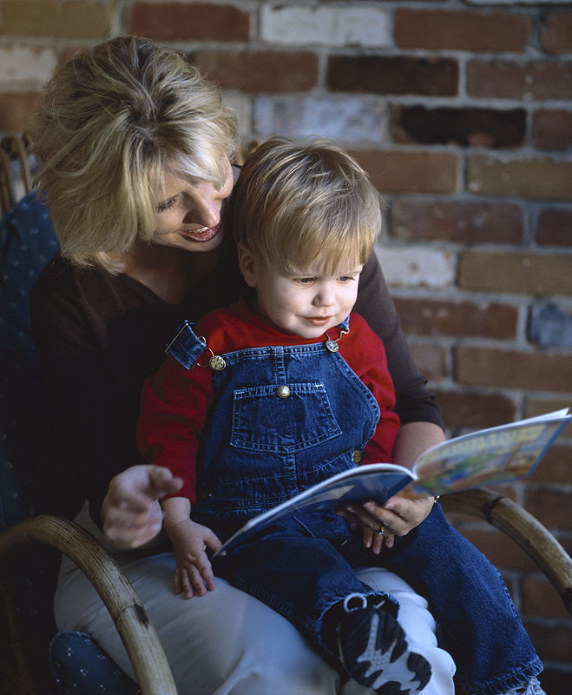
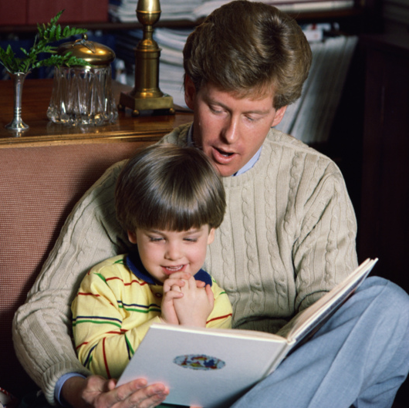
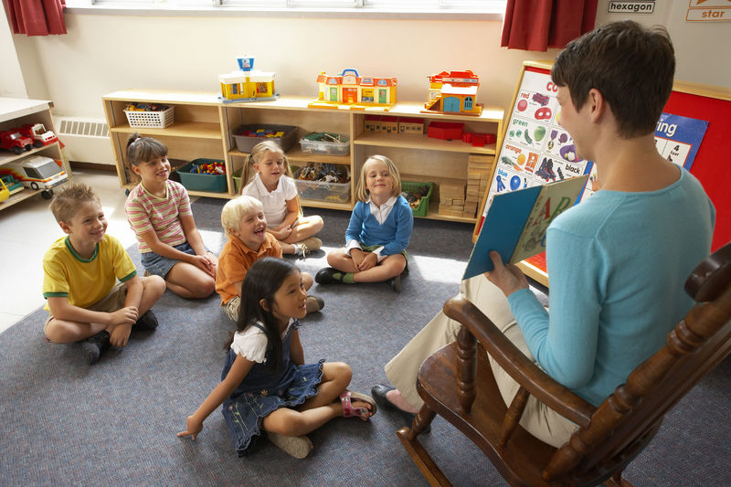
How did you learn
to read?
People
reading
to you.
Notes:
Mama & papa & teachers
reading to you.

Slide 3
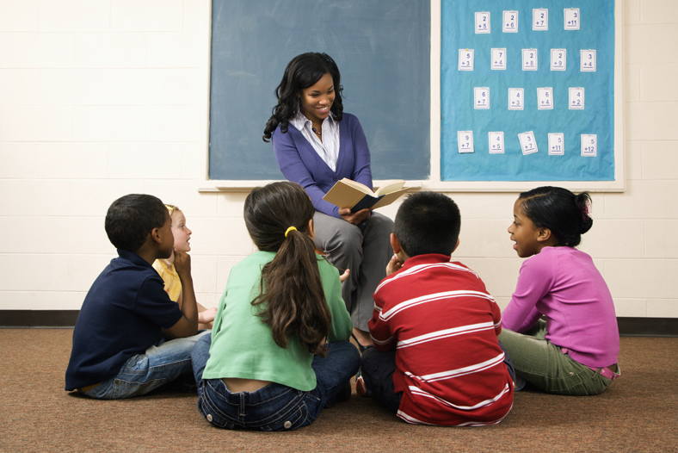
What’s
important?

Slide 4

Don’t
just
read

Slide 5
Tell
the
story

Slide 6

Use
your
voice

Slide 7

Loud voice
sometimes.

Slide 8
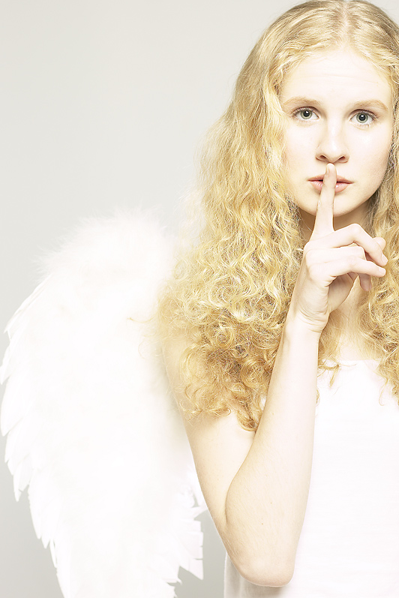
Softer voice
sometimes.

Slide 9
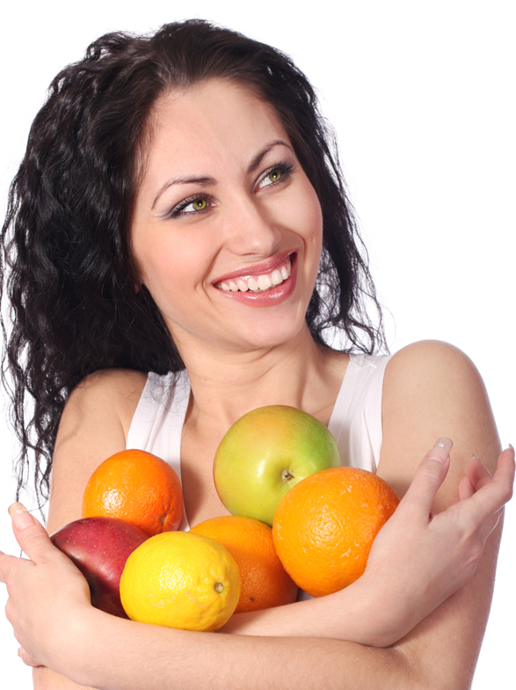
Your voice
must
show
emotion

Slide 10

Your voice
must
show
emotion

Slide 11
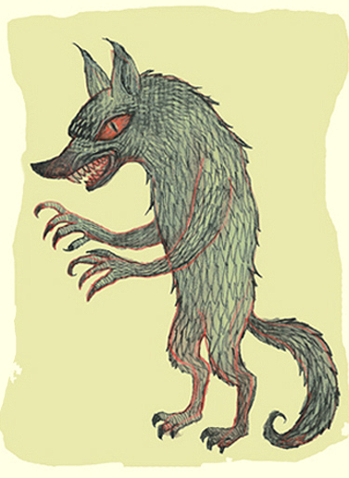
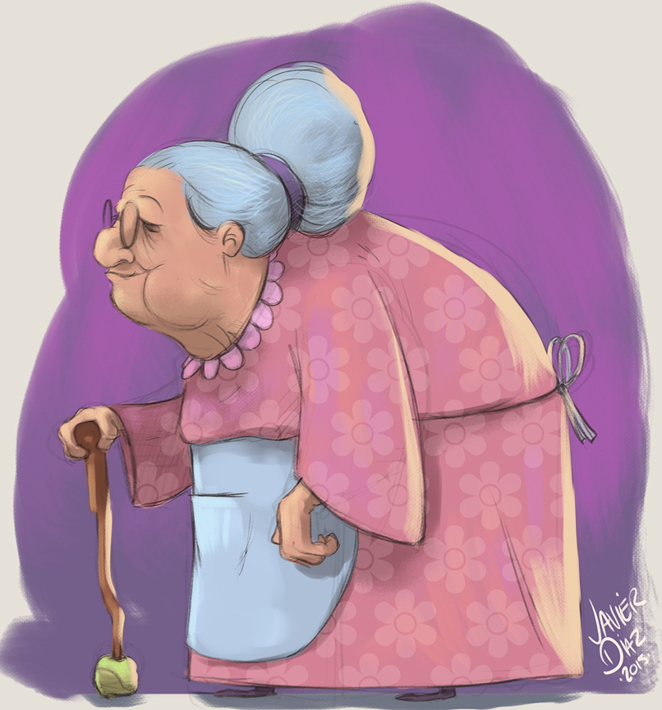
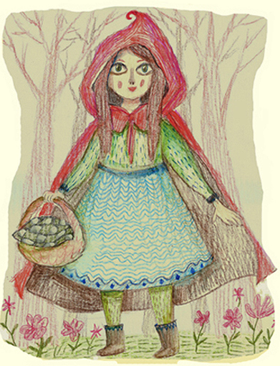
Use
voices
What big
eyes you have
Grandma!
The better to
eat you,
my dear!
The better to
see you,
my dear!
Art credit: v-l-a-d-i-m-i-r.deviantart.com

Slide 12
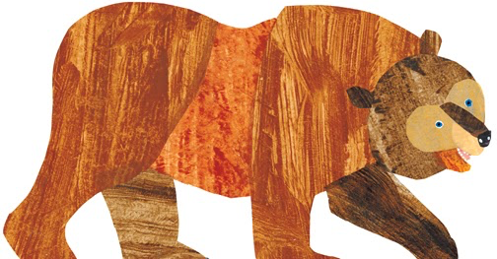
Let the
kids
see
What’s she
forgetting?
Art credit: Eric Carle

Slide 13
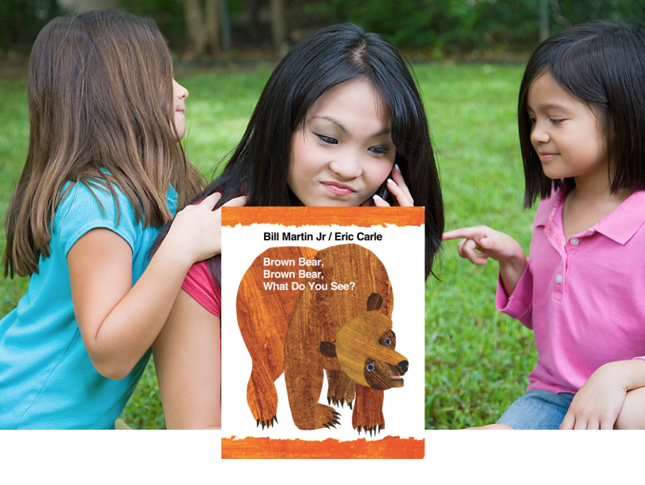
Art credit: Eric Carle
Connect with the story

Slide 14
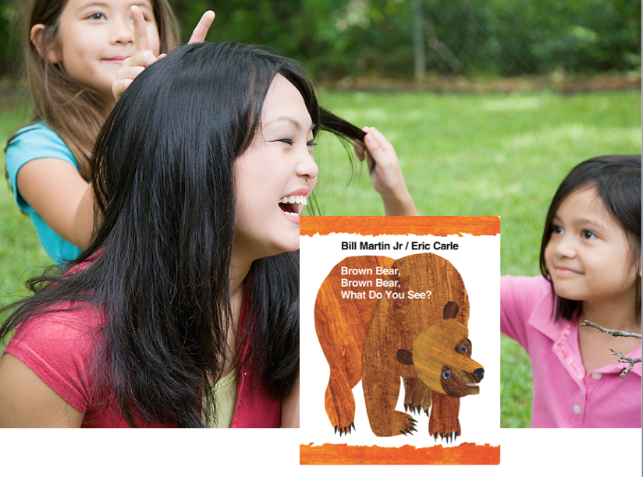
Art credit: Eric Carle
Connect with the story
& with the kids

Slide 15
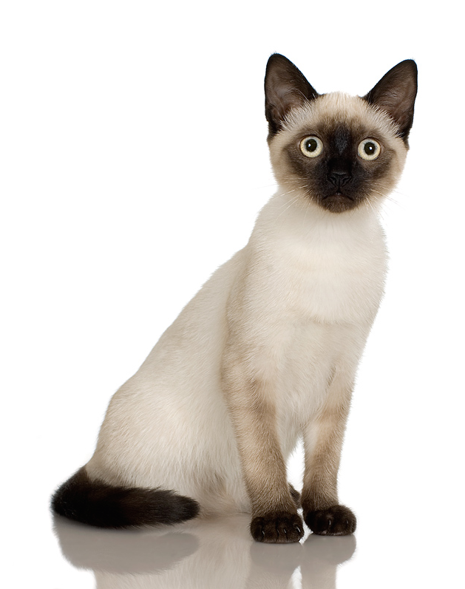
Eye contact

Slide 16
Eye contact

Slide 17
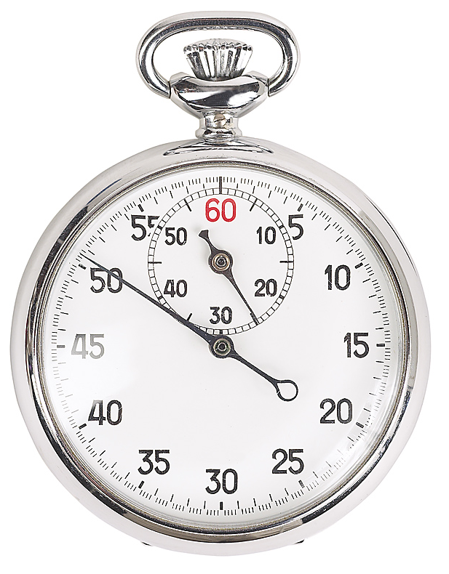
Work with a partner.
Get a “big book.”
Read to each other.
Use the ideas.
Practice
Time.

Slide 18
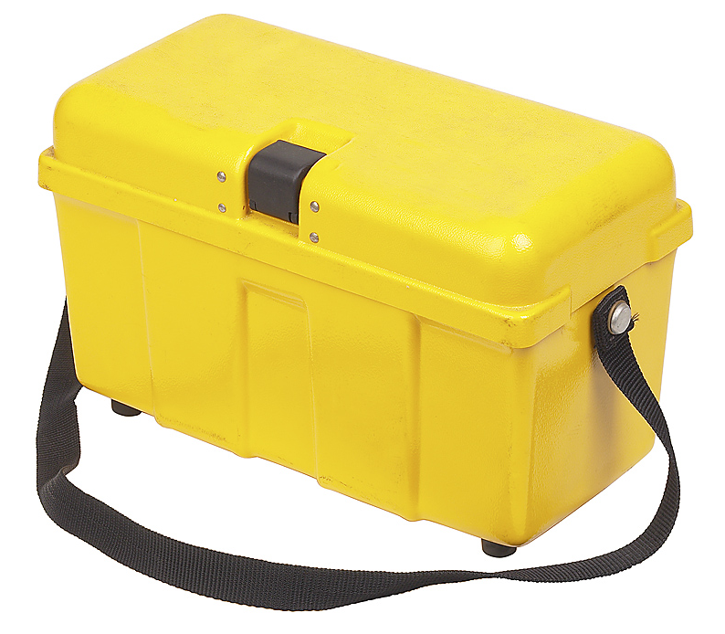
Techniques

Slide 19

Kids
say
next
word.
Stop!

Slide 20

Ask questions.
What’s this?
What color is that?
What’s ____ in English?

Slide 21
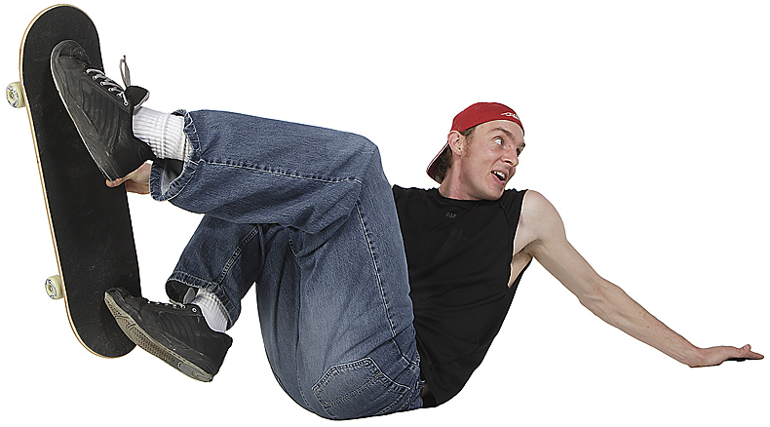
Make mista e k s.
Let the kids “correct” you.

Slide 22

Have kids
notice things.
Who can find the letter “F”?
What is this word?
Who can find “dog”?

Slide 23
Practice again.
Use the main ideas
& the techniques.
Practice
Time #2

Slide 24
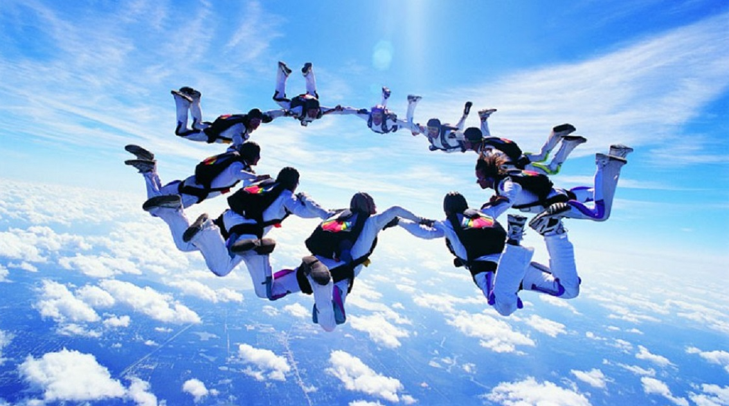
Join another pair. Tell your story.
Group work

Slide 25
Have fun!
If you do,
the kids will, too.

