Slide 1
Energy break

Slide 2
Standing back bending stretch
Stand up.
Set your feet straight and shoulder-width apart.
Raise your arms.
Bend your upper body backward.
Sit down.

Slide 3
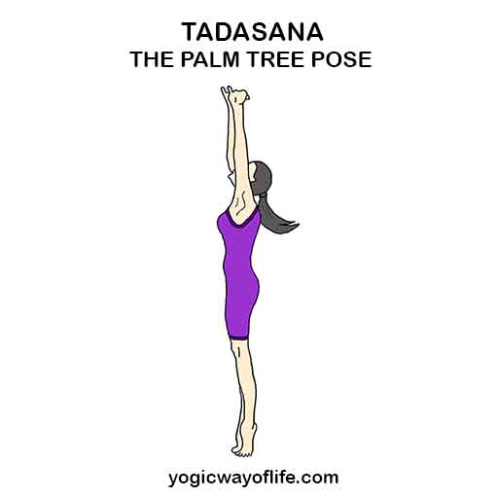
Palm tree pose
Stand up
Raise your arms and bring them in line with your shoulders.
Raise your heels off the floor.
Keep this pose for 5 seconds.
Bring your heels down.
Repeat it 5 times.
Sit down.

