Slide 1
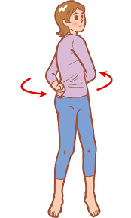
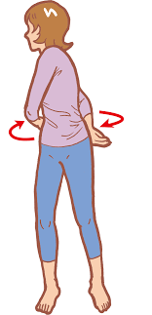
Energy Break＃1
１.Stand up
2 .Move your arms to left and right around your body
3.Continue for 30 seconds
4.Sit down

Slide 2
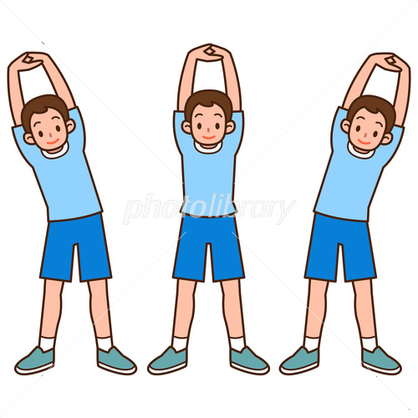
Energy Break＃2
１．Stand up
２．Lock the fingers of both hands together, raise your arms, and turn your palms upward
3. Bend your body from the waist to left and right
4. Continue for 30 seconds
5. Sit down

Slide 3
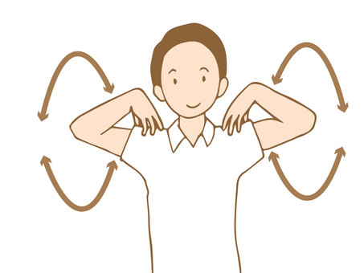
Energy Break＃3
１．Stand up
２．Put your hands on your shoulders
3. Turn your shoulders forward and backward
4. Continue for 30 seconds
5. Sit down

