Slide 1
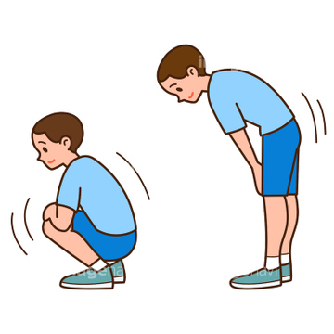
Energy Break
Stand up
Squat with both hands on your knees
for 2 seconds
3.Keep your hands on your knees and stand
for the same time
4. Sit down
Do this 3 times
Aiko Iitsuka

