Slide 1
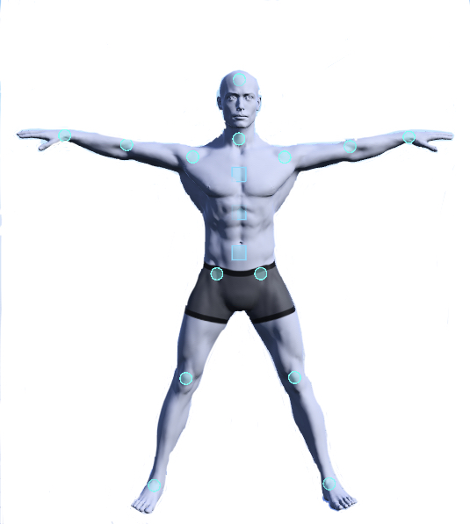
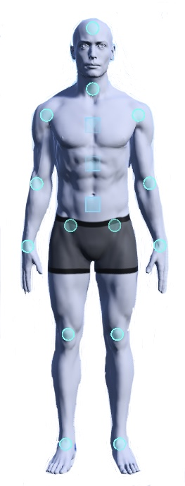
Energy Break
Stand with good posture.
Spread your arms and legs.
Shout out the name of your favorite fruit.
Do this 5 times.
Ms. Hayashi
apple

