Slide 1
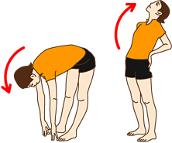
ENERGY BREAK
Forward bend
/Back bend
Stand up
Bend your body forward
Raise your upper body
Bend your back
Do this FOUR times
By Ms. Fukushima

