Slide 1
Exploring Extensive Reading to Sustain and Renew ELT Reading Instruction
Doreen Ewert, University of San Francisco
Brenda Johnston, New Westminster Secondary School, BC. Canada
Marc Helgesen, Miyagi Gakuin Women’s University, Sendai, Japan
Lynn Schaefer , University of Central Arkansas, Conway, AK.
Tom Robb, Kyoto Sangyo University, Kyoto, Japan

Slide 2
Extensive
Reading
= ER

Slide 3


Slide 4
Overview
Part One: Whole Group (40 minutes)
Introduction to ER (Doreen)
IEP Stand-alone ER Course (Doreen)
ER for High School (Brenda)
ER in Asia (Marc Helgesen)
ER in Reading Circles (Lynn)
Moodle Reader Quizzes (Tom)

Slide 5
Overview
Part Two: Small Groups (50 minutes)
You have approximately 15 minutes each for the three small groups:
  EFL
  ESL Secondary
  ESL Higher Education
Handouts will be distributed in each group.

Slide 6
Overview
Part Two: Small Groups (50 minutes)
You have approximately 15 minutes each for the three small groups:
  EFL
  ESL Secondary
  ESL Higher Education
Handouts will be distributed in each group.

Slide 7
The basic problem
“Students learning to read a second language do not read, and they do not like to read.”
(Eskey, 1986, cited in Day & Bamford, 1998, p. 4).

Slide 8
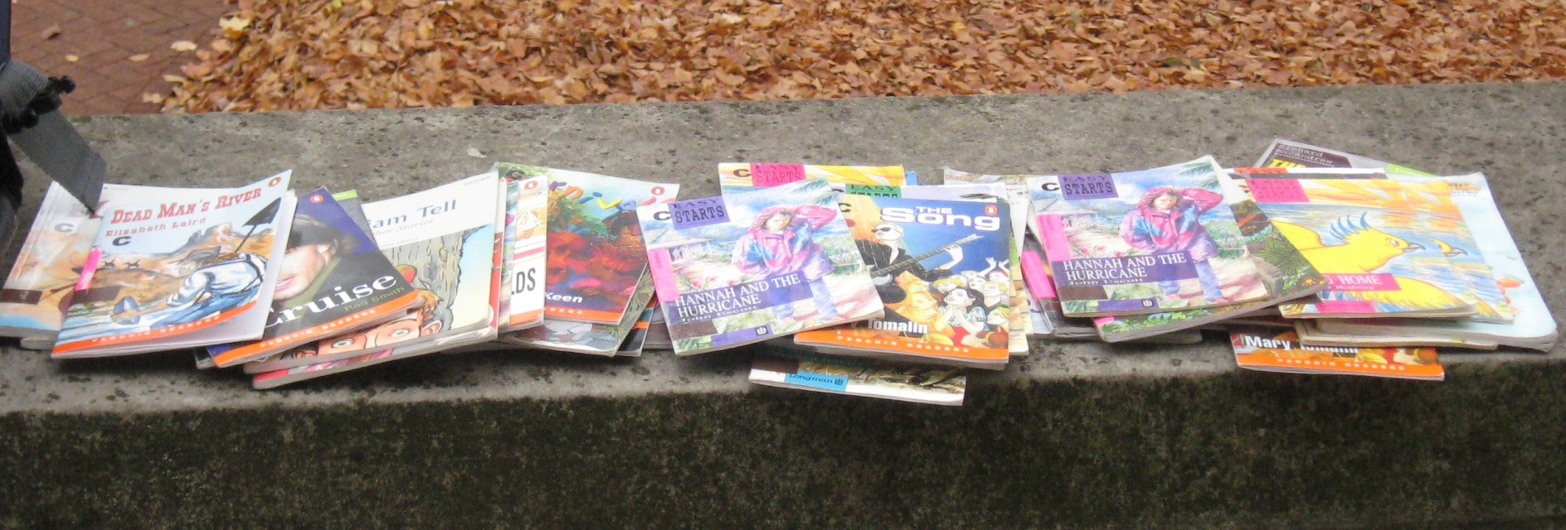
Extensive Reading Definition
Quickly reading large amounts of self-selected, easy, varied, and interesting material.

Slide 9
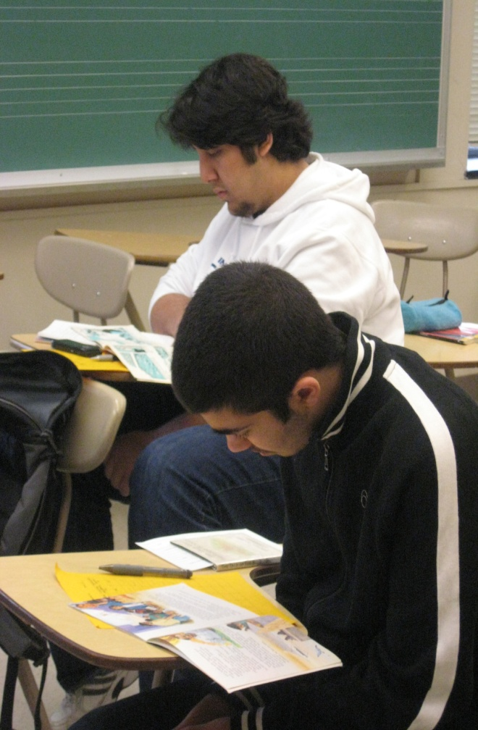
Journal Excerpts
“I read a lot of books in the class. I could understand almost all, but there were some difficult words and topics. However, I could enjoyed from book’s information. I learned fun of reading, because it was my first time to read in English.”

Slide 10

Why is ER not common in North American
ESL programs?
The second language context fallacy
The active role of the teacher belief
The focus of ESL materials on explicit teaching and explicit learning
Lack of awareness of the role of implicit learning and how to motivate it
Backlash against basal readers
The myth of the authentic text

Slide 11

Rationale for Extensive Reading
  Development of positive attitude/motivation for L2 reading.
  Development of sight words (over-learning for automaticity).
  Development of general
  vocabulary knowledge.
  Development of different
  knowledge types.

Slide 12
Characteristics of an Extensive Reading Program
Original in Day & Bamford, 1998, p. 7-8)
The reading material is easy.
Students read as much as possible, perhaps in and definitely out of the classroom
A variety of materials on a wide range of topics is available so as to encourage reading for different reasons and in different ways.
Students select what they want to read and have the freedom to stop reading materials that fails to interest them.
The purposes of reading are usually related to pleasure, information, and general understanding. These purposes are determined by the nature of the material and the interests of the student.

Slide 13
Original in Day & Bamford, 1998, p. 7-8)
Reading is fast. The materials are well within the linguistic competence of the students in terms of vocabulary and grammar. Dictionaries are rarely used while reading because the constant stopping to look up words makes fluent reading difficult.
Reading is individual and silent, at the student’s own pace, and, outside class, done when and where the student chooses.
Teachers orient students to the goals of the program, explain the methodology, keep track of what each student reads, and guide students in getting the most out of the program.
The teacher is a role model of a reader for students—an active member of the classroom reading community, demonstrating what it means to be a reader and the rewards of being a reader.
Reading is its own reward. There are few or no follow-up exercises after reading.

Slide 14

Day (2011)
Pure ER
10 principles
Modified ER
Many principles
ER Light
Some principles
Not ER

Slide 15
Intensive vs. Extensive Reading
Type of Reading | Intensive Reading | Extensive Reading
Class goal | read accurately | read fluently
Reading purpose | answer questions study | get information enjoy
Focus | words pronunciation | meaning
Material | teacher chooses often difficult | you choose easy
Amount | not much | a lot
Speed | slower | faster
Method | must finish use dictionary | stop if you don’t like it no dictionary
Adapted from Day & Bamford, 1998.

Slide 16
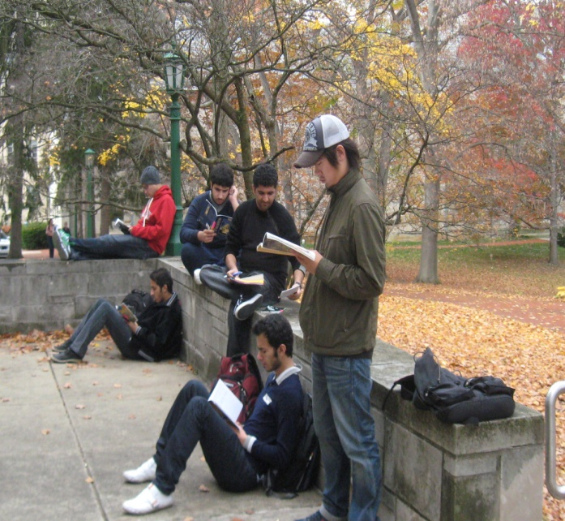
IEP Extensive Reading Program
Low intermediate proficiency
One hour a day
Pass/Fail
Main goal: ENJOY
Extensive Reading Log (ER log) 25%
Extensive Reading Journal 25%
Attendance and Participation 25%
Self Evaluation 25%

Slide 17
Sample Schedule
Week | Monday | Tuesday | Wednesday | Thursday | Friday
1 | Intro to Extensive Reading | Motivation for Reading in English Questionnaire Homework | EPER Test | EPER day Make-up EPER Test | EPER day Make-up EPER Test
2 | EPER day Make-up EPER test | Syllabus Why read fiction? How to choose books | Education Library visit | Library book day Music Library | EPER day
3 | Intro: Journals Book chat | EPER day | Intensive and Extensive Rdg EPER day | Public Library prep. EPER day | Library book day IMU So. Lounge
4 | EPER day | Book chat | Public Library visit | Library book day Chemistry Library | EPER day
5 | EPER day | Library book day Neal Marshall Library | EPER day | Book Chat | EPER day
6 | EPER day | Book chat | Library book day Fine Arts Library | EPER day | Evaluations
7 | EPER day | EPER test | Library book day students’ choice

Slide 18
Sample Schedule
Week | Monday | Tuesday | Wednesday | Thursday | Friday
1 | Intro to Extensive Reading | Motivation for Reading in English Questionnaire Homework | EPER Test | EPER day Make-up EPER Test | EPER day Make-up EPER Test
2 | EPER day Make-up EPER test | Syllabus Why read fiction? How to choose books | Education Library | Library book day Music Library | EPER day
3 | Intro: Journals Book chat | EPER day | Intensive and Extensive Rdg EPER day | Public Library prep. EPER Day | Library book day IMU So. Lounge
4 | EPER day | Book chat | Public Library | Library book day Chemistry Library | EPER day
5 | EPER day | Library book day Neal Marshall Library | EPER day | Book Chat | EPER day
6 | EPER day | Book chat | Library book day Fine Arts Library | EPER day | Evaluations
7 | EPER day | EPER test | Library book day students’ choice

Slide 19
Sample Schedule
Week | Monday | Tuesday | Wednesday | Thursday | Friday
1 | Intro to Extensive Reading | Motivation for Reading in English Questionnaire Homework | EPER Test | EPER day Make-up EPER Test | EPER day Make-up EPER Test
2 | EPER day Make-up EPER test | Syllabus Why read fiction? How to choose books | Education Library visit | Library book day Music Library | EPER day
3 | Intro: Journals Book chat | EPER day | Intensive and Extensive Rdg EPER day | Public Library prep. EPER Day | Library book day IMU So. Lounge
4 | EPER day | Book chat | Public Library visit | Library book day Chemistry Library | EPER day
5 | EPER day | Library book day Neal Marshall Library | EPER day | Book Chat | EPER day
6 | EPER day | Book chat | Library book day Fine Arts Library | EPER day | Evaluations
7 | EPER day | EPER test | Library book day Students’ choice

Slide 20
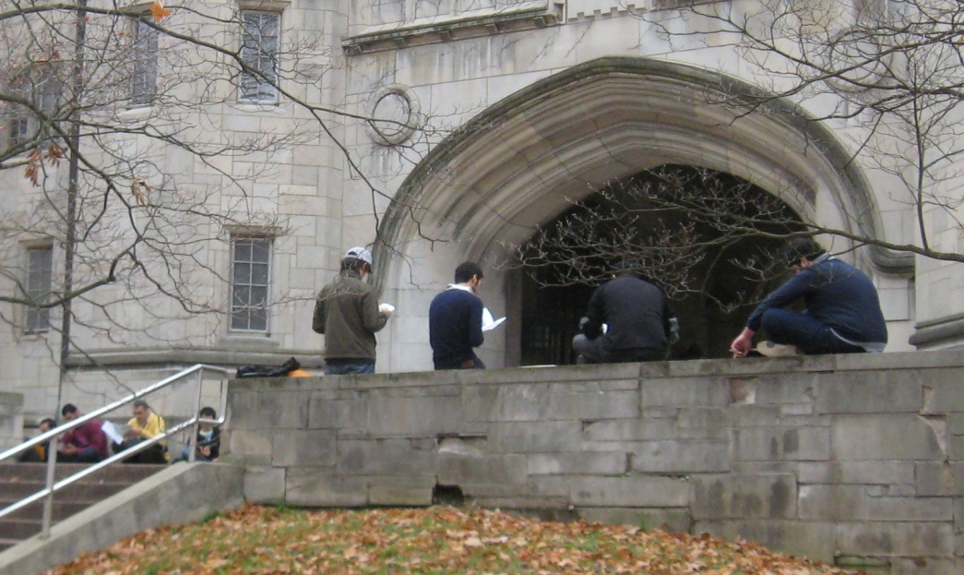
Journal Excerpts
“I have a little experienced in reading in English because in general about reading I do not like read so much even in my native language which is Arabic....When I went to education library I felt I can choose the books better than in the past and most of books that I chosen them I interested of them I like them.”

Slide 21
Extensive Reading in Secondary
ELL Classes
Brenda Johnston, New Westminster Secondary School, BC. Canada

Slide 22
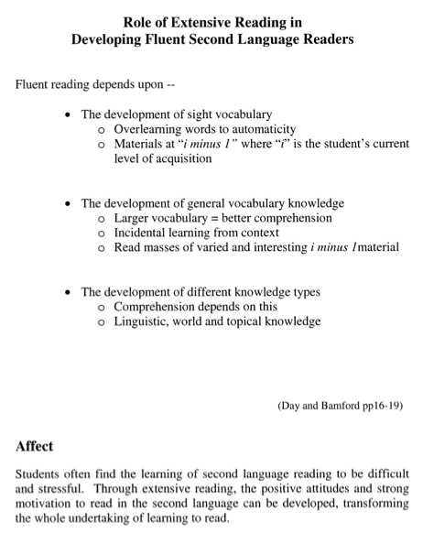

Slide 23
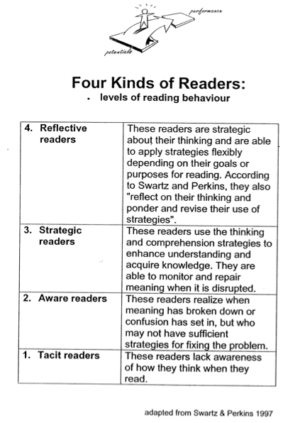

Slide 24
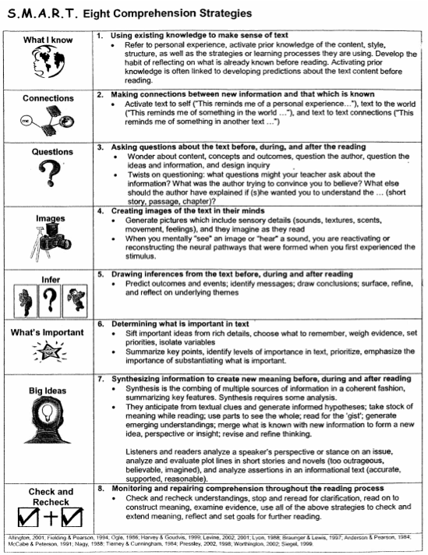

Slide 25
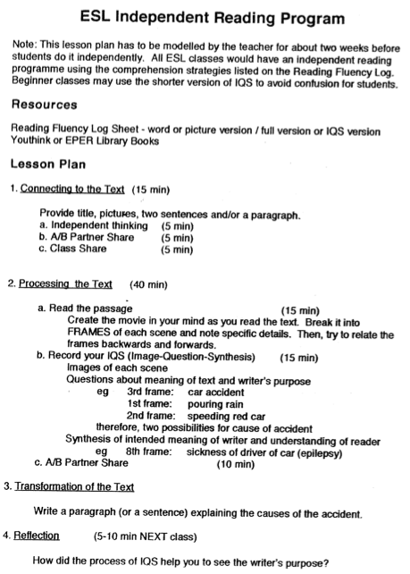

Slide 26
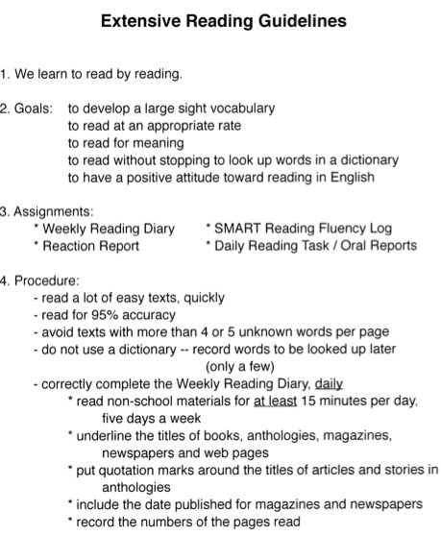

Slide 27
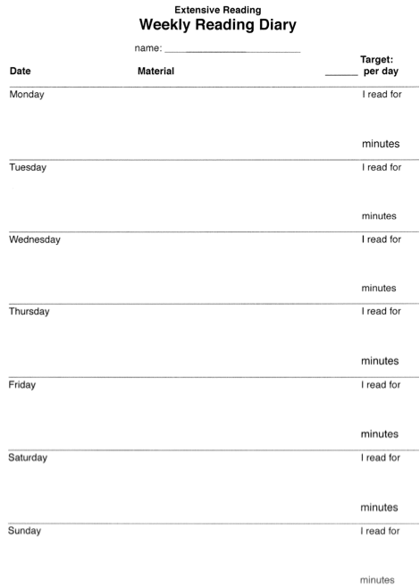

Slide 28
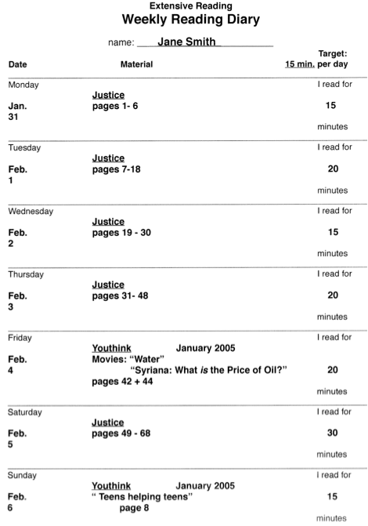

Slide 29
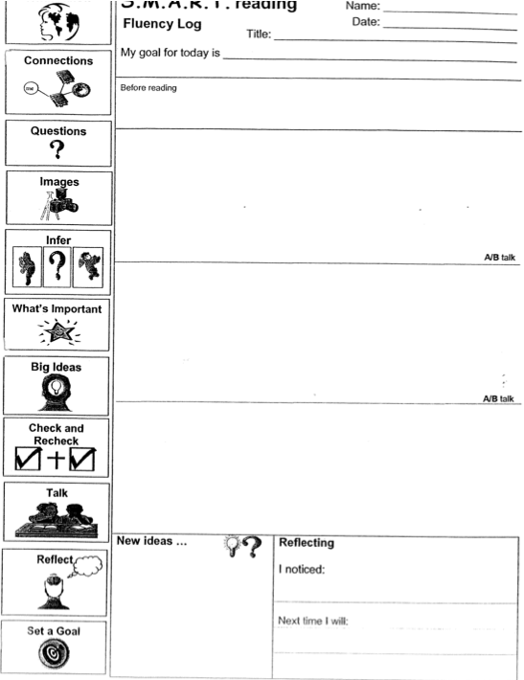

Slide 30
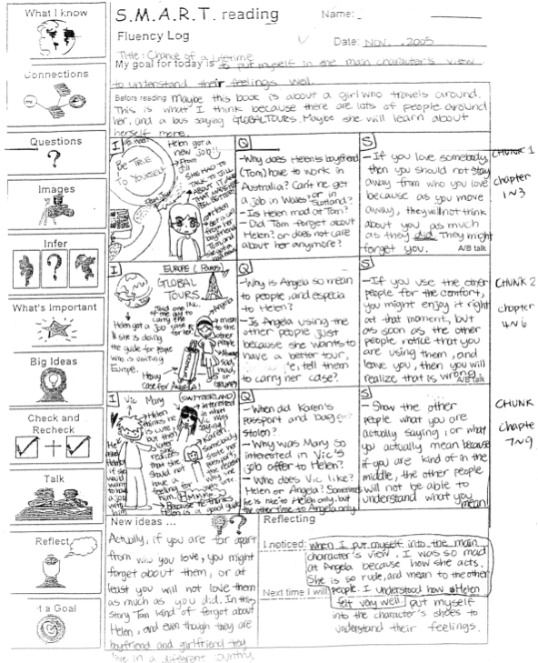

Slide 31
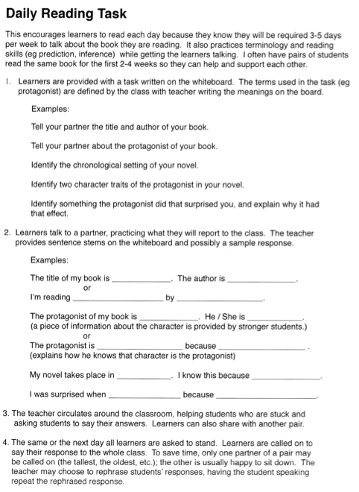

Slide 32
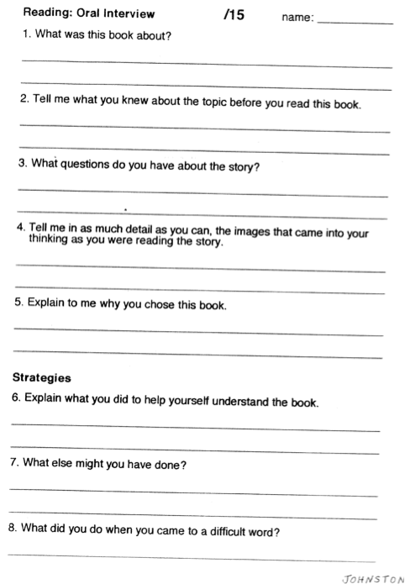

Slide 33
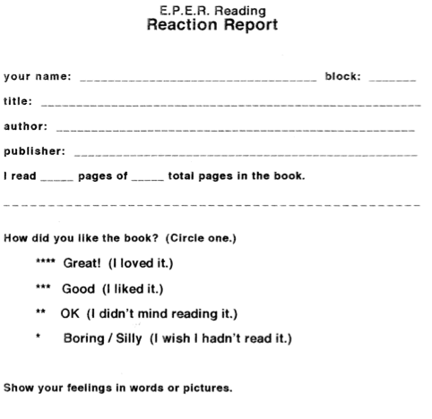

Slide 34
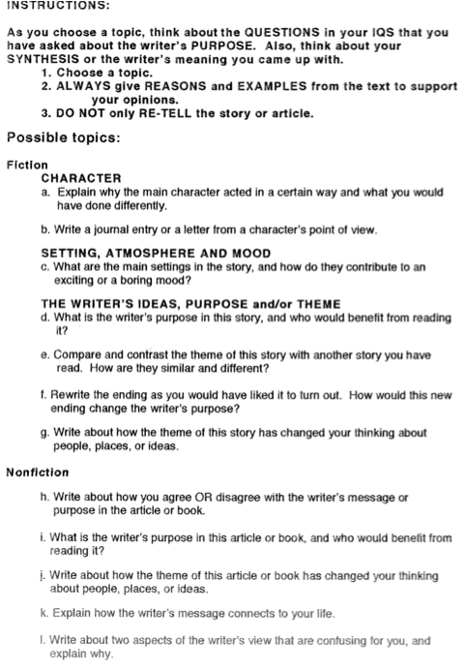

Slide 35
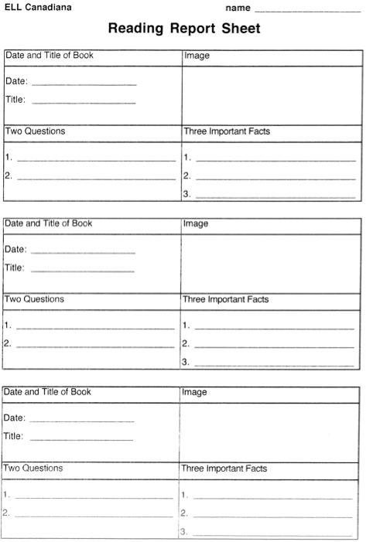

Slide 36
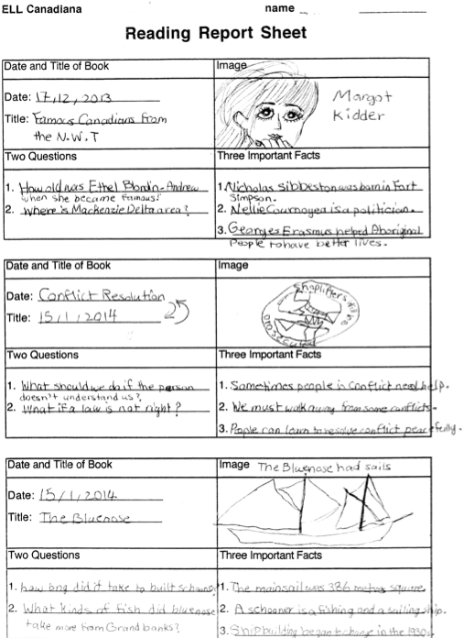

Slide 37

ER in
Asia

Slide 38
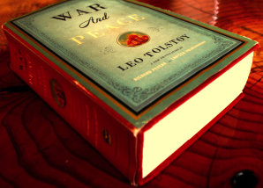

Slide 39


Slide 40
ER in
Asia

Slide 41


Slide 42





Slide 43
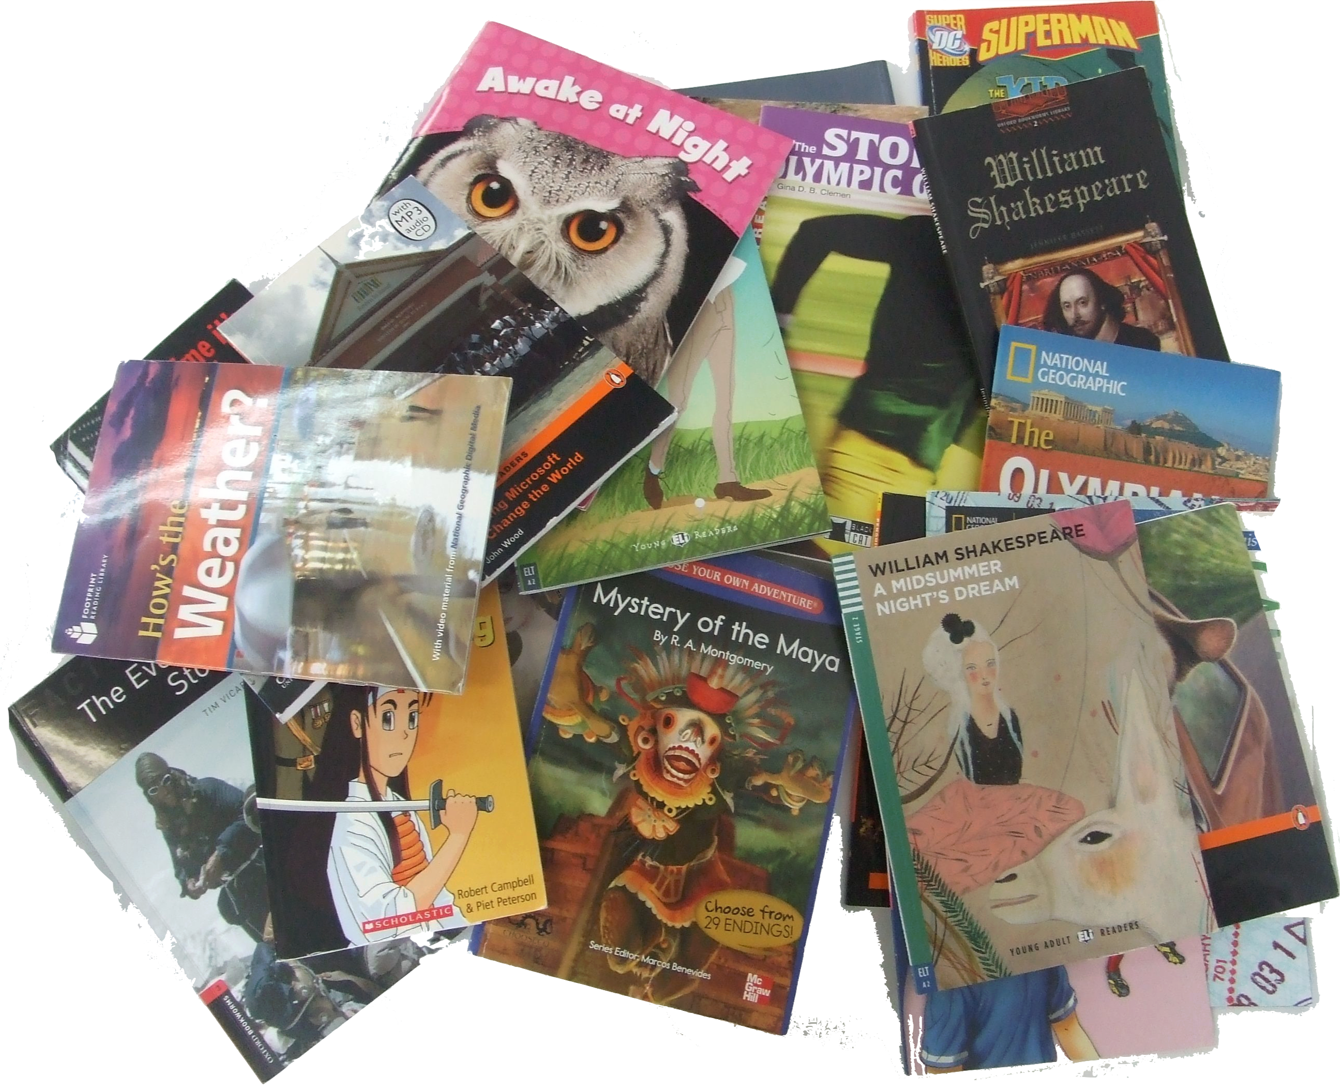

Slide 44



>400 participants/
20 countries
>600 participants/
Notes:
Internation conference – US, Canada, Mexico, Europe, MidEast – but vast majority,Asia,
Pretty much every East and South east asian country.

Slide 45
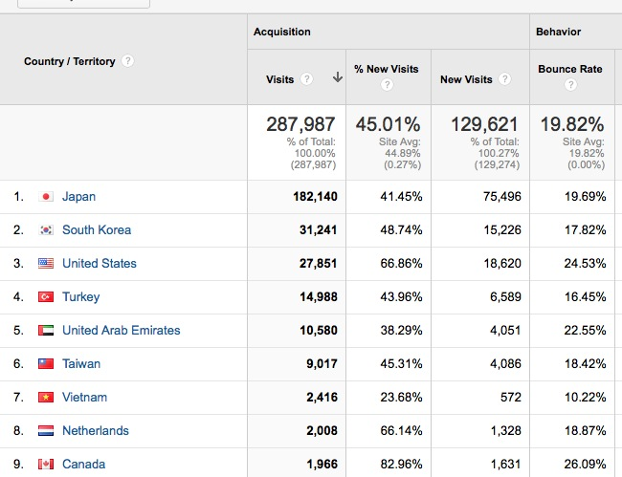
MReader
77%

Slide 46
ER in
Asia
Notes:
Sendai Japan – 29 years this summer. Write mainly for Pearson Education Longman Asia and am an author of English Firsthand – Longman Asia’s best selling series.
Note - “A” view, not “the” view. Thousands of people in ELT in Asia.

Slide 47

How long?

Slide 48
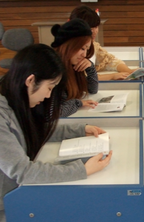
SSR
Sustained
Silent
Reading
(You too.)
Notes:
10-15 minutes of class time
Values reading
Practical thing – they bring books
Classroom management-
Unless you teach kids,

Slide 49

SSR
Sit
Still &
Read
Notes:
Unless you teach kids,

Slide 50
Reading for pleasure
Reaction Report - Basic
Include:
• what the book was about
• what you thought of it)
What happened?
------------------
Your opinion:
Write quickly.
10 minutes or less.
Good ☺ p Average 😐 p Poor ☹
Good ☺ p Average 😐 p Poor ☹
Notes:
ER is a new idea for most Ss (used to intensive/ yakudoku/ read & translate).
Nothing wrong with staring reports where they expect. NOTICE: YOUR OPINION! -- APPRECIATIO

Slide 51
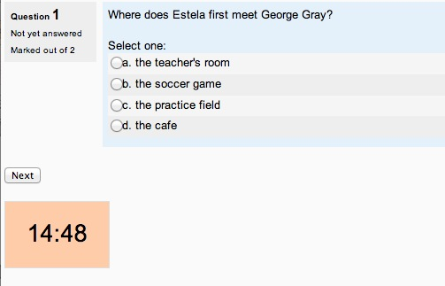
Multiple Choice

Slide 52

Social collaboration
Notes:
Opportunities for social collaboration
The book report .

Slide 53
Instant book report
I read (am reading) a book called ____.
It's a(n) _______________
(mystery, science fiction book,
love story, detective story, etc.)
It's about ______________.
The main characters are ____________.
(names, jobs, personalities)
In the story, there was a problem. ____.
 I liked/didn't like it because _______.
Notes:
THEY DO

Slide 54
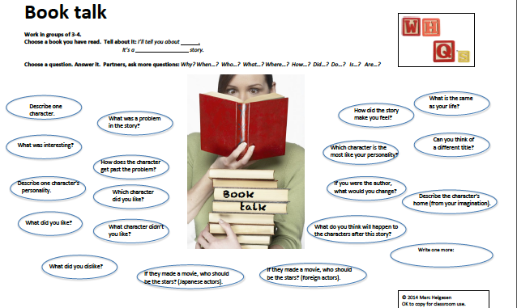
Insert book talk slide
Notes:
Note questions. Easy on the left. More challenging on the right.
Based on Ss rating.
Piloted for difficulty and interest.

Slide 55

Exams
Notes:
JHS and HS study is for university entrance exams.
Not communicative. Not task based. Normally no speaking and rarely listening.

Slide 56
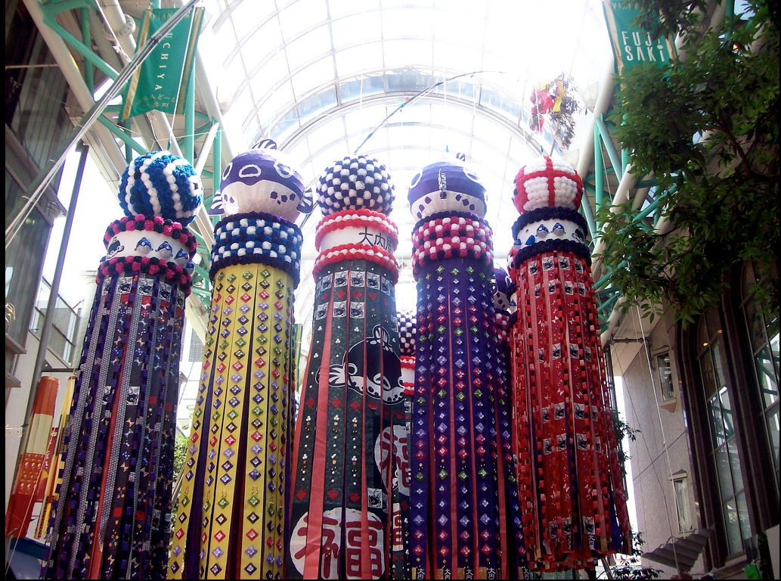
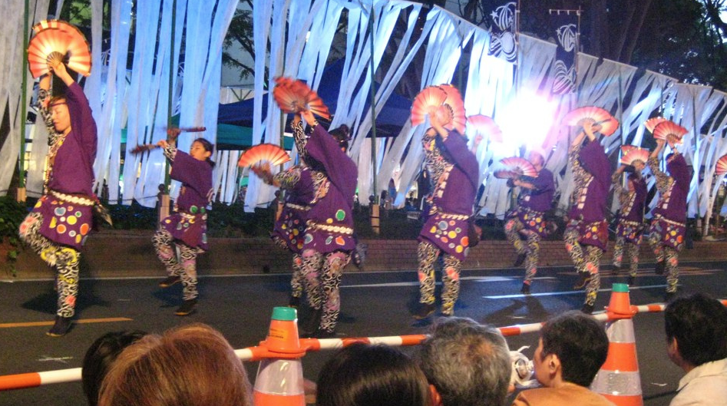

Slide 57

Exams
Notes:
JHS and HS study is for university entrance exams.
Not communicative. Not task based. Normally no speaking and rarely listening.

Slide 58


      No reading pain,
      no reading gain.
ER
The macho maxim of reading
Notes:
Credit Richard Day

Slide 59

ER:
reading
a lot of easy, enjoyable books.

Slide 60

Easy
is good

Slide 61
Easy
Comprehensible input (Krashen)
i + 1
Reading fluency level (Day)
i minus 1

Slide 62
Easy
…builds speed
…builds fluency
…builds understanding

Slide 63
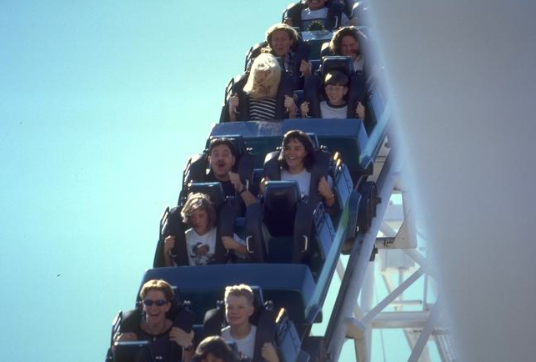
The need
for
speed
Notes:
Hard to explain,
Easy to demonstrate

Slide 64
When

Slide 65
you

Slide 66
read

Slide 67
slowly,

Slide 68
one

Slide 69
word

Slide 70
at

Slide 71
a

Slide 72
time,

Slide 73
as

Slide 74
you

Slide 75
are

Slide 76
doing

Slide 77
now,

Slide 78
it

Slide 79
is

Slide 80
easy

Slide 81
to

Slide 82
understand

Slide 83
the

Slide 84
meaning

Slide 85
of

Slide 86
each

Slide 87
word,

Slide 88
but

Slide 89
it

Slide 90
is

Slide 91
very

Slide 92
difficult

Slide 93
to

Slide 94
understand

Slide 95
the

Slide 96
real

Slide 97
meaning

Slide 98
of

Slide 99
the

Slide 100
text.

Slide 102
When you read slowly,
one word at a time,
as you are doing now,
it is easy to understand
the meaning of each word,
but it is very difficult to
understand the real
meaning of the text.

Slide 104
The need for speed
Don’t
understand
much
Read slowly
Don’t
read
much
Don’t enjoy
reading
Notes:
Credit Richard Day

Slide 105
The need for speed
Understand
more
Read faster
Read
more
Enjoy reading

Slide 106
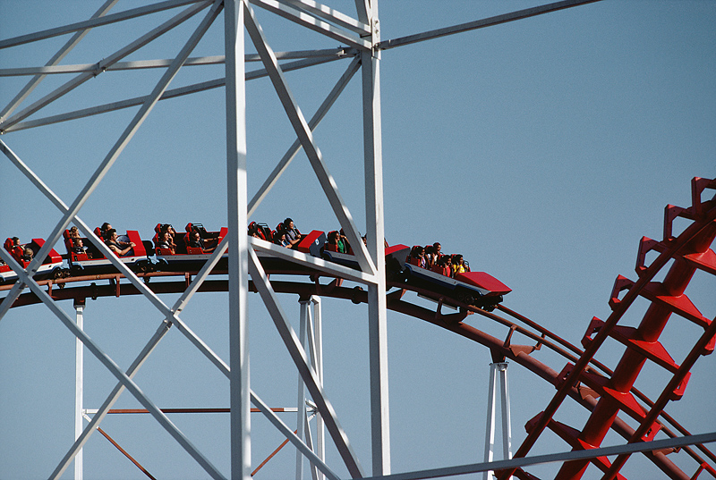
How fast?

Slide 107
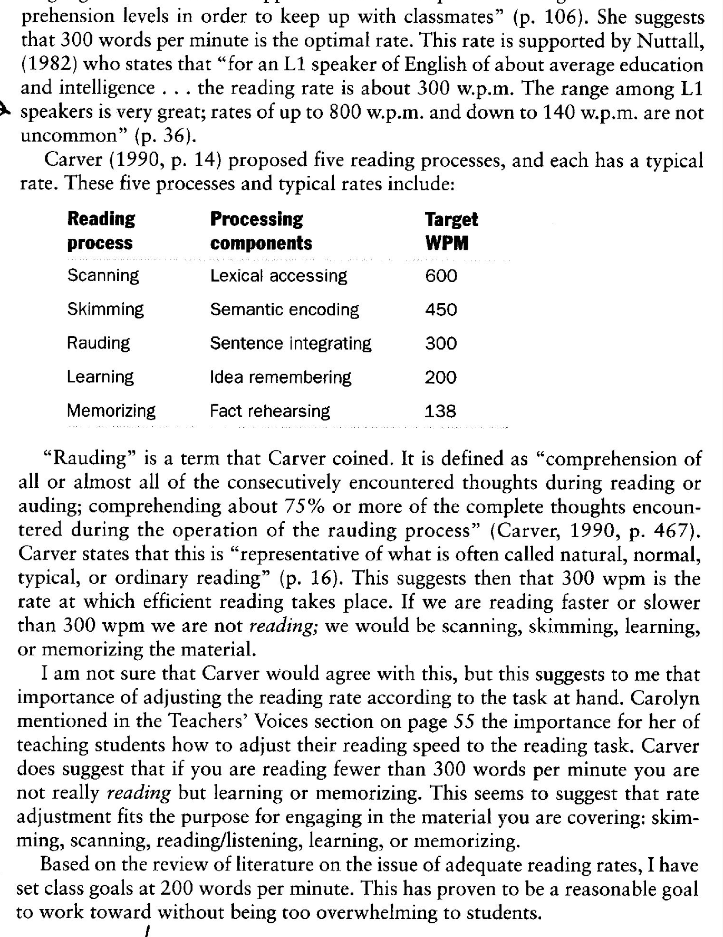
Reading & purpose
Process Components Target WPM
Scanning Lexical accessing 600
Skimming Semantic encoding 450
Rauding Sentence integrating 300
Learning Idea remembering 200
Memorizing Fact rehearsing 138
Carver (1990) quoted
in Anderson (1999)
Notes:
Rauding (Carver’s term) about 75% comprehension.
This quoted in Exploring Second Language Reading 1999. Heinle

Slide 108
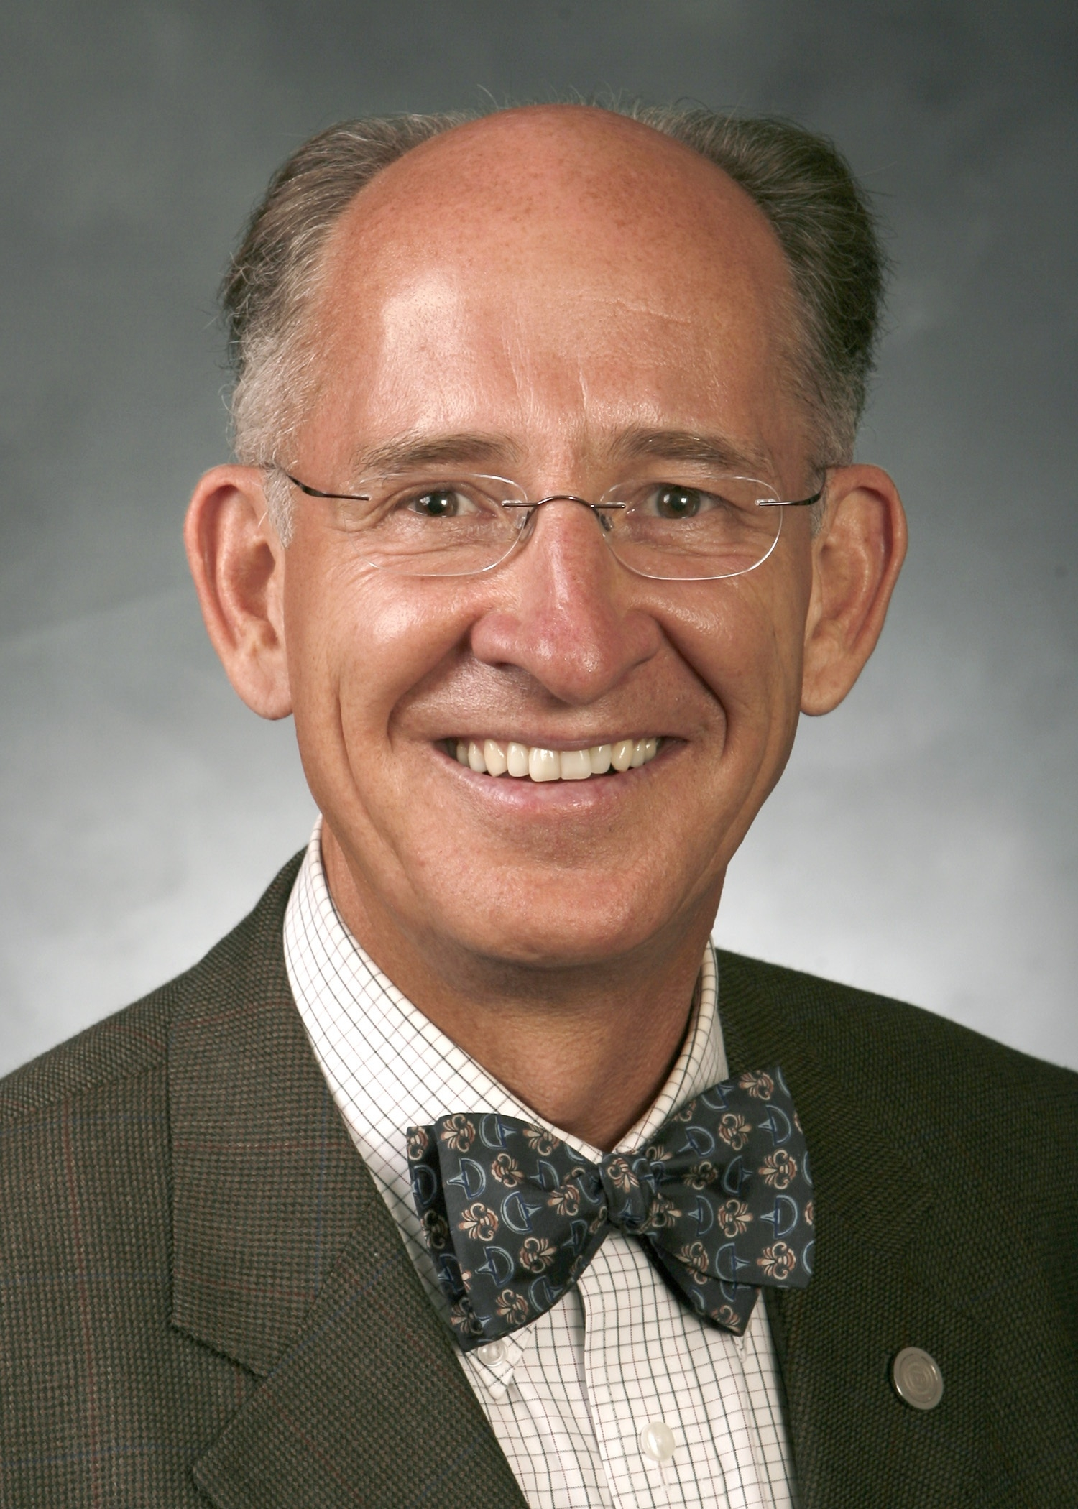
Based on the review of literature
on the issue of adequate reading
rates, I have set class goals at
200 words per minute. This has
proven to be a reasonable goal to
work toward without being too
overwhelming to students.
- Neil Anderson
Brigham Young University
Past President, TESOL

Slide 109
Easy
is good

Slide 110

5-Finger Rule
1-2 new words
= too easy
3 = perfect
4 = challenge level
5+ = too difficult
Notes:
Rule of thumb (or rule of fingers).
Any page – in the middle.

Slide 111

www.erfoundation.org

Slide 112


Thank you.
Creative Commons : PHOTOSof.org
Notes:
http://photosof.org/view/open_book_with_love_heart_in_folded_pages-wide.htm

Slide 113





Slide 123
American student volunteers
Expanding the circle
Final projects
Resources
http://www.oup-bookworms.com/
http://www.eflliteraturecircles.com/
extensivereading.net

Slide 124
Mreader.org

Slide 125


Slide 126
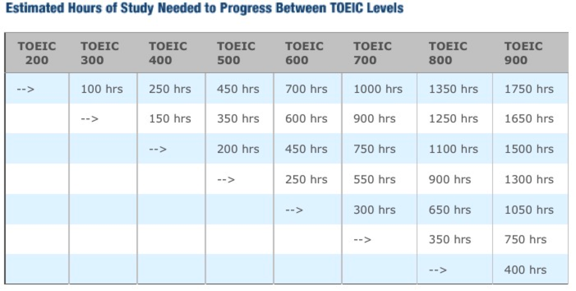
Study Hours Required for Advancement
A1 A2 B1 B2 C1 C2
http://www.prolingua.co.jp/toeic_e.html

Slide 127
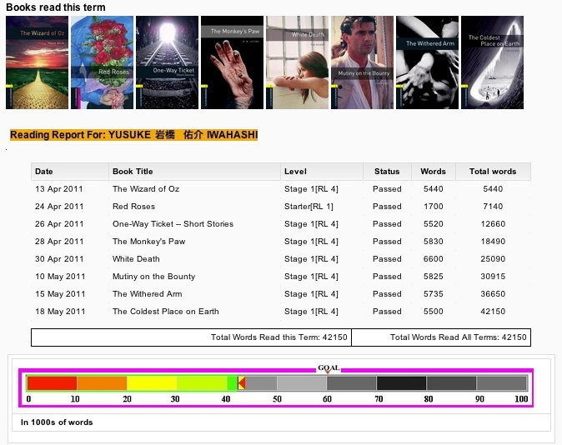

Slide 128
Mreader Features
Quizzes on over 3700 readers
10 randomized questions
Level-controlled
Timed
Enforced time interval between quizzes
Determines “Read”/“Not Read”
Free for schools to use

Slide 129
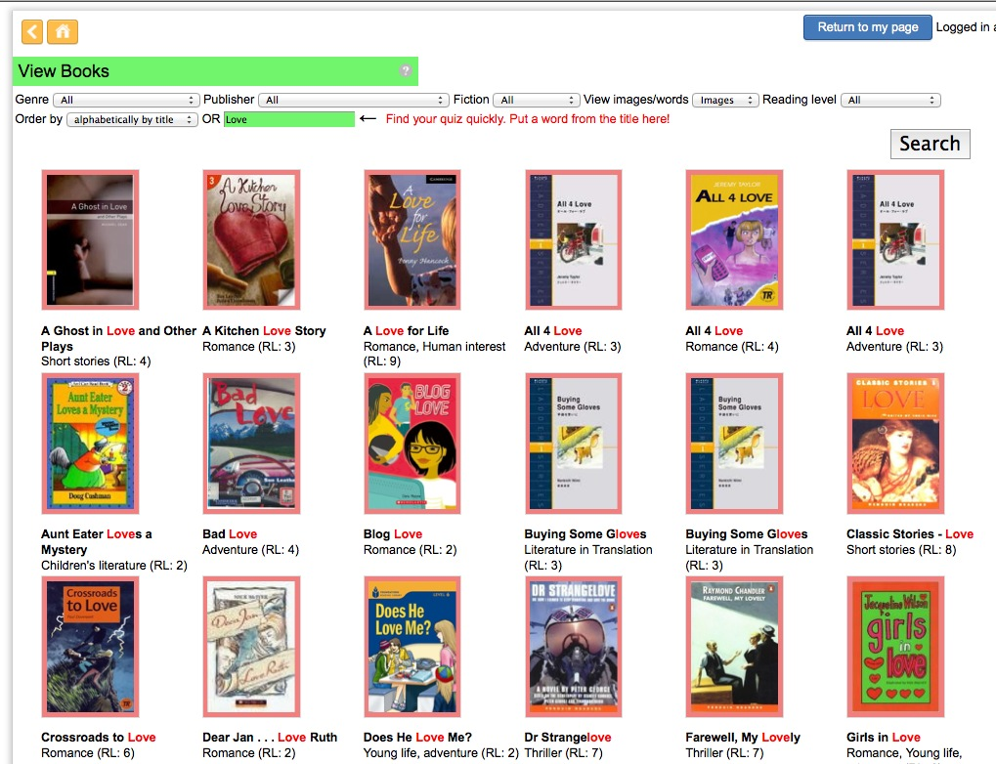
Searching for a book with “Love” in the title

Slide 130
Multiple Choice

Slide 131
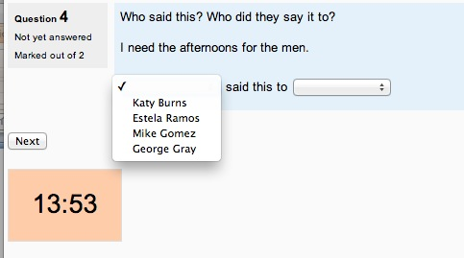
Who said….?

Slide 132
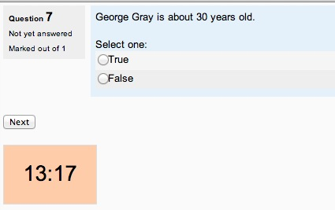
True / False

Slide 133
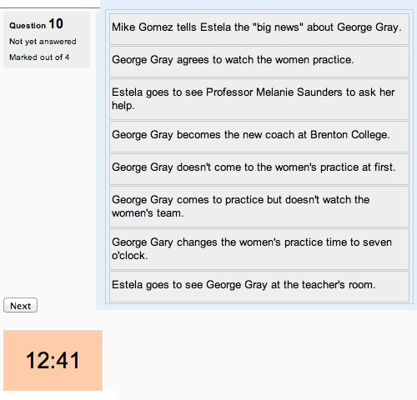
Ordering

Slide 134
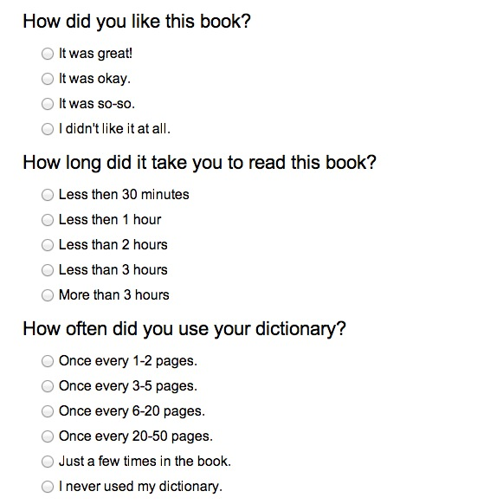
Post-Quiz Questions (1)

Slide 135
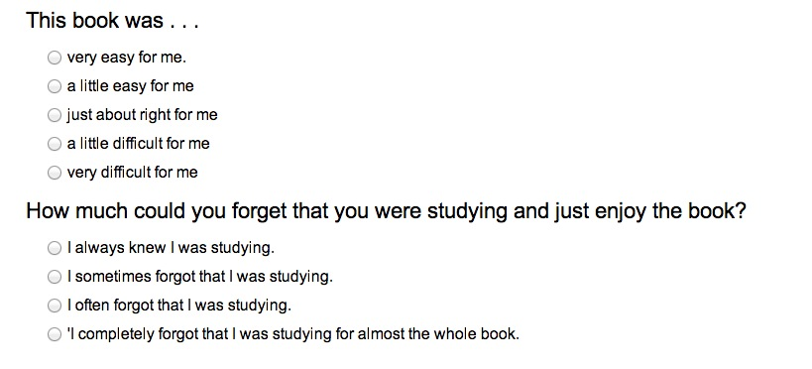
Post-Quiz Questions (2)

Slide 136
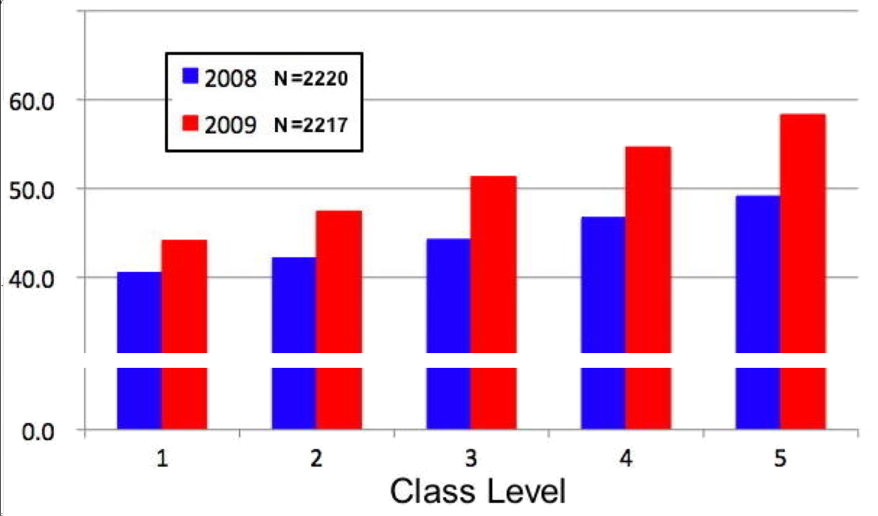
Reading Improvement by class level
(using MoodleReader in 2009)

Slide 138
Part two
Small Groups (50 minutes)
You have approximately 15 minutes each for the three small groups:
  EFL
  ESL Secondary
  ESL Higher Education
Handouts will be distributed in each group.

Slide 139

Free booklet.
English
Spanish
Japanese
Korean
Soon in Arabic
www.erfoundation.org

Slide 140
Thank you.
Creative Commons : PHOTOSof.org
Notes:
http://photosof.org/view/open_book_with_love_heart_in_folded_pages-wide.htm

