Slide 1
Energy breaks
Human beings were not designed to sit in desks all day. Energy breaks are a series of short, physical activities you can use to get your students moving and energized.
TaiChi is an exercise activity.
TaiChi #1-#3 each introduce about 1 minute of the
series. Tai Chi 5-minute routine does a full routine.
On #2 and #3, the words appear after the pictures about the benefits of Tai Chi. You can see if the students remember.
References are on the last slide.
Thanks to Satsuki McNeill for suggesting this.
© Marc Helgesen. May be freely used for non-commercial purposes.
For more, visit: www.HelgesenHandouts.weebly.com. Click on “Physical activity…”
This slide is for the teacher’s information. The student slide show starts with slide 2.

Slide 2
Energy break

Slide 3
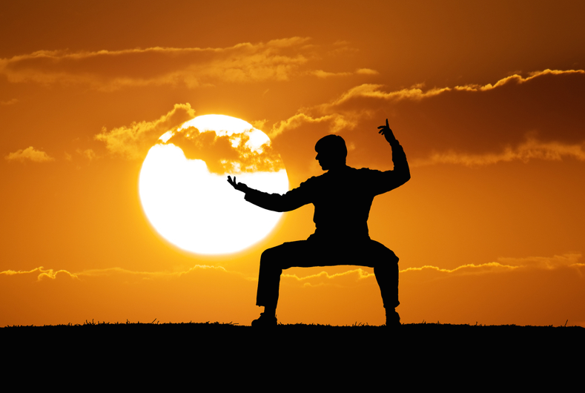
Tai Chi #2

Slide 4
says
Tai chi
may
improve
brain
health
Referencing

Slide 5
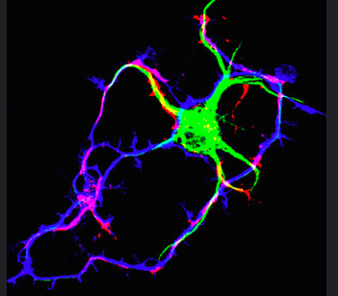
says
Tai chi
may
promote
neuro-
plasticity
Referencing
Art: journal of
Cell Biology

Slide 6
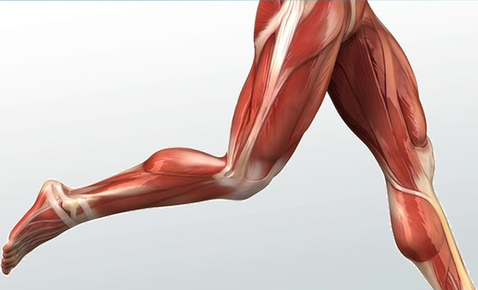
says
Tai chi
speeds up
muscle
recovery
Art: Study.com
Referencing

Slide 7
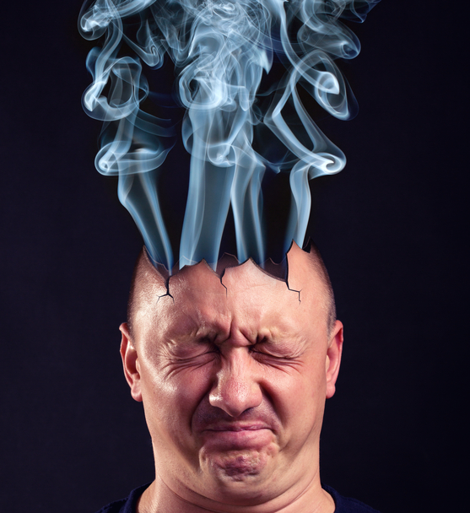
says
Tai chi
reduces
stress &
anxiety
stress
Referencing

Slide 8
Let’s try! -1 minute

Slide 9
Full video:
Tai Chi 5 minutes a day Module 01
https://www.youtube.com/watch?v=cEOS2zoyQw4&t=411s
Psychology reference:
Wei, M. (4/24/2018) Tai Chi May
Improve Brain Health and Muscle
Recovery. Psychologytoday.com
Thanks to Satsuki McNeill for
suggesting this.

Slide 10
Let’s move!

Slide 11
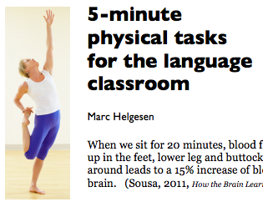
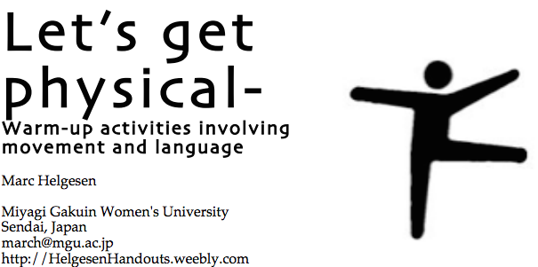
More ideas at
http://tinyurl.com/ELT-physical

