Slide 1
This presentation is © 2018 Marc Helgesen. Previous versions are © 2010- 2018 Marc Helgesen. All rights reserved.
It may be used by teachers with their students. It may NOT be used for teacher training in commercial ways without the specific permission of Marc Helgesen. Any such use is illegal, a copyright violation and unethical.
Most of the photographs are © clipart.com. They are used under license. Marc – check rajio taiso video

Slide 3
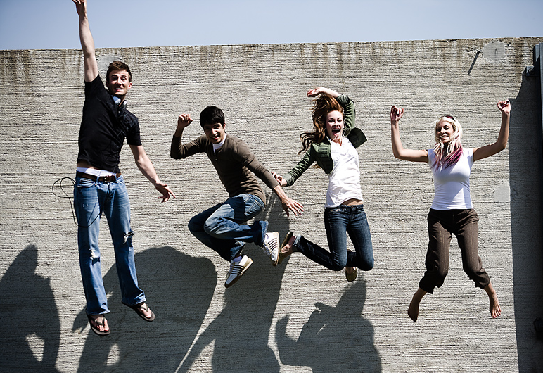

Let’s get physical
Let’s get physical!
Marc Helgesen
Notes:
2 contrast ideas:
Stand 4-5 meters away from computer. Can you read it (contrast plus font)
Print out and photocopy in black and white)

Slide 4


Let’s get physical
Let’s get physical!
Marc Helgesen
Notes:
2 contrast ideas:
Stand 4-5 meters away from computer. Can you read it (contrast plus font)
Print out and photocopy in black and white)

Slide 5
Let’s get physical
Let’s get physical!
The Brain / Body
Connection
Notes:
2 contrast ideas:
Stand 4-5 meters away from computer. Can you read it (contrast plus font)
Print out and photocopy in black and white)

Slide 6
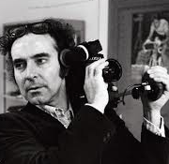
“I like a film to
have a beginning,
a middle
and an end…
but not necessarily
in that order.”
- - - - Jean Luc Godard
- Jean Luc Godard

Slide 7


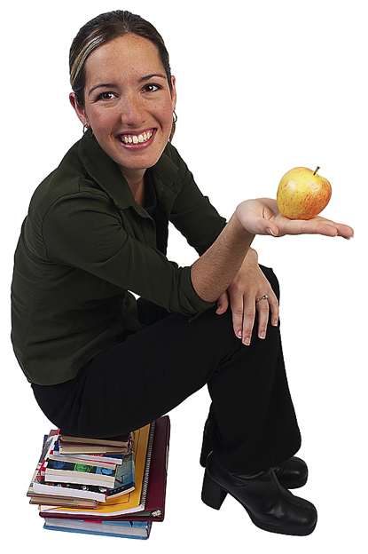
Accent/Stand up
Notes:
Note – there are several versions of this slide at the bottom of the file.

Slide 8


Pronunciation:
/ l / / r /
light
right
Notes:
8

Slide 9
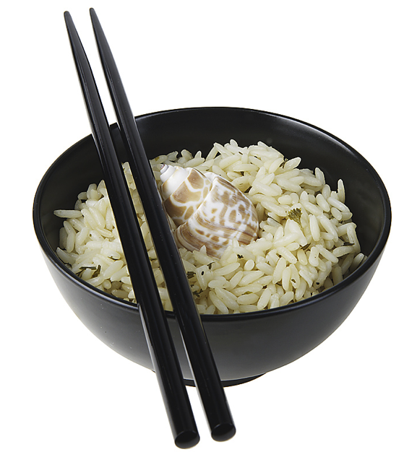
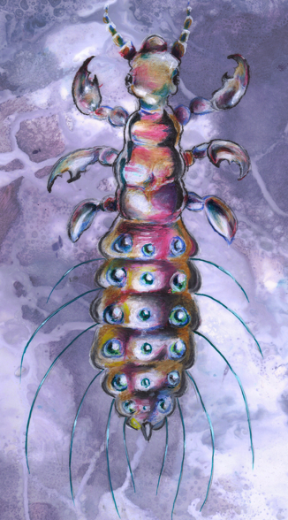
Pronunciation:
/ l / / r /
lice
rice
Notes:
9
No mi

Slide 10
Accent/Stand up
Nationalities
Accent /Stand up
Accent /Stand up
Vietnamese
Vietnamese
British
British
Filipino
Filipino
American
American
Chinese
Chinese
Korean
Korean
Australian
Australian
Aussie
Aussie
Notes:
Note – there are several versions of this slide at the bottom of the file.

Slide 11
Let’s get physical
Let’s get physical!
Notes:
2 contrast ideas:
Stand 4-5 meters away from computer. Can you read it (contrast plus font)
Print out and photocopy in black and white)

Slide 12
Let’s get physical
The brain/body
connection
Notes:
2 contrast ideas:
Stand 4-5 meters away from computer. Can you read it (contrast plus font)
Print out and photocopy in black and white)

Slide 13
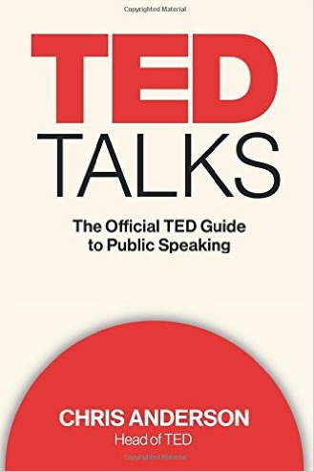
I’ll share reasons & ways we can & should use physical activities
in our classes
Throughline
< 15 words

Slide 14
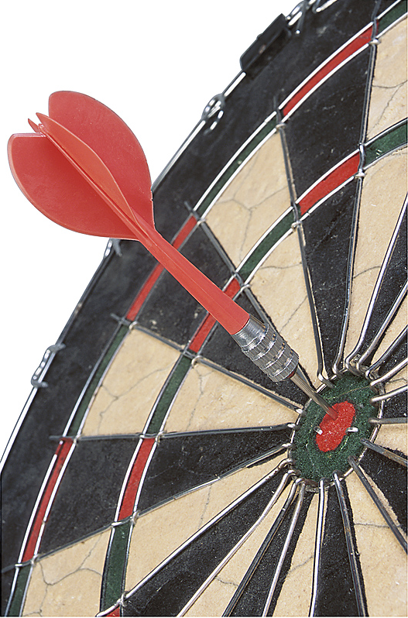
Goals:
share
activities
reasons
brain
science

Slide 15
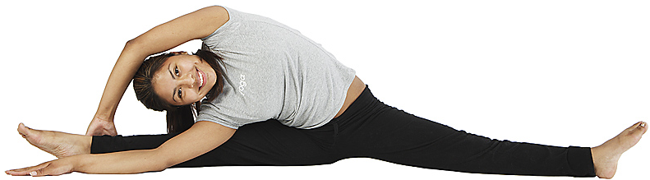
Why physical?

Slide 16
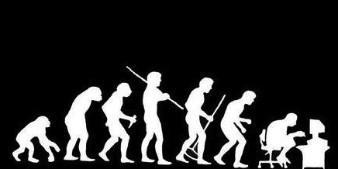
10 - 20 km/day
Medina 2014

Slide 17
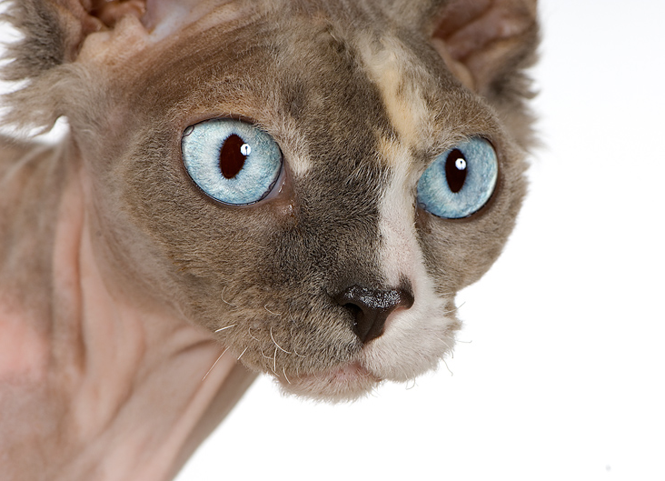
They
pay attention
Notes:
Our students busy – class 1-2-3 times a week .
They are thinking about other classes, part-time jobs,
Boyfriends/girlfriends. LIFE,
These get Ss involved

Slide 18
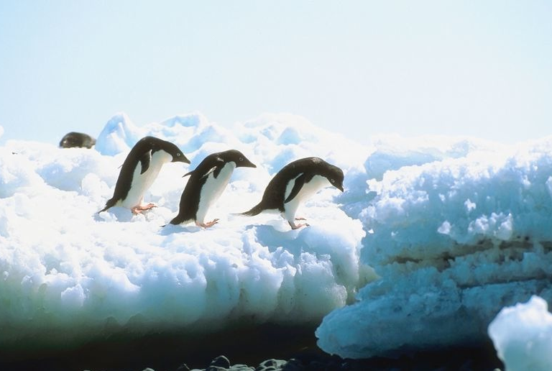
Gets learners thinking
in the same direction
Schema activation
Notes:
Come in 1-2-3 times a week. Other stuff in their lives. Other classes, part-time jobs, boyfriends/girlfriends.
SCHEMA Activation

Slide 19
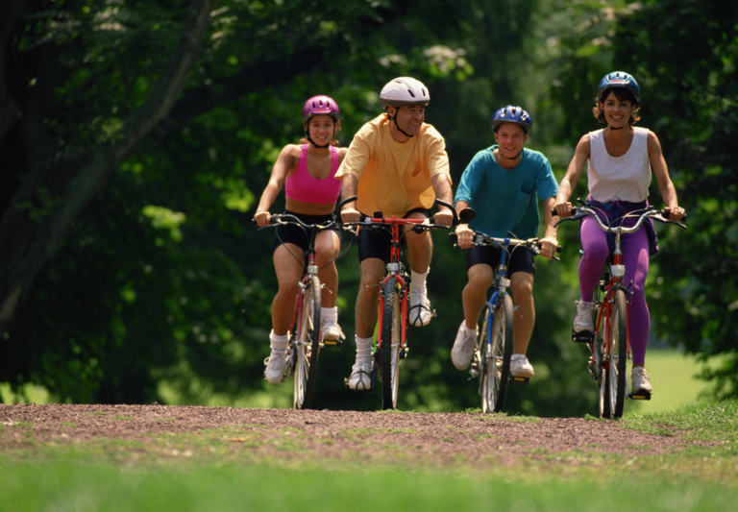
Learning
by doing
Notes:
Maybe deepest learning – there’s a reason you never forget how to ride a bicycle.
TPR.

Slide 20
What’s “physical” got to do with brain science?

Slide 21
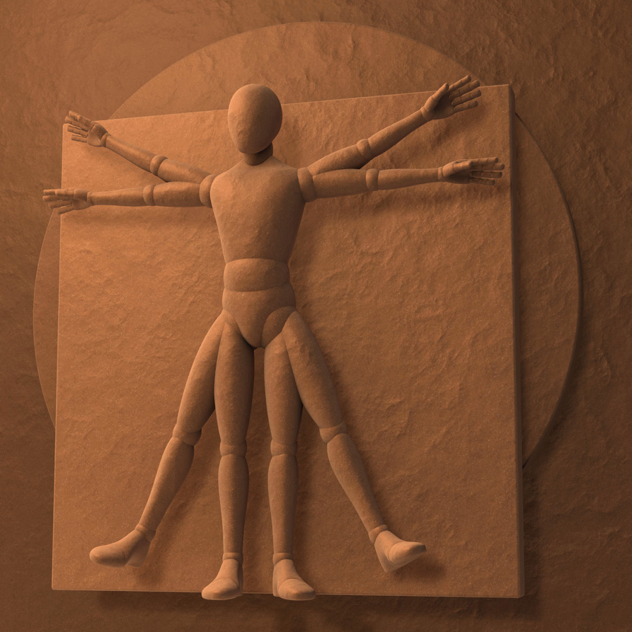
Your
body
is
like a
“second brain”
Notes:
Second brain: separate nervous system. So complex, like a 2nd brain.

Slide 22
Your
body
is
like a
“second brain”
Especially
the “gut”
where many
neurons are
located
Notes:
Second brain: separate nervous system. So complex, like a 2nd brain.

Slide 23
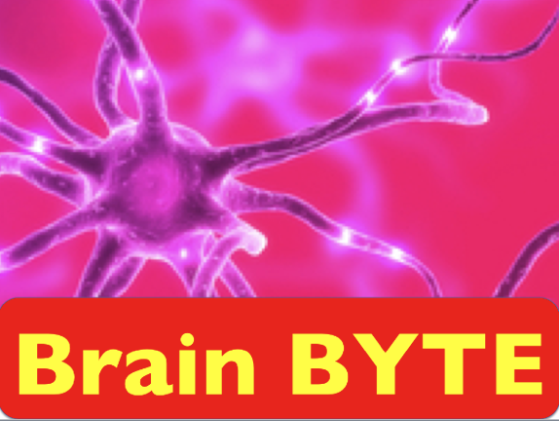
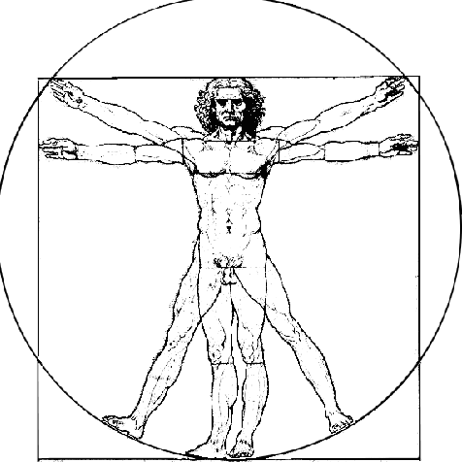
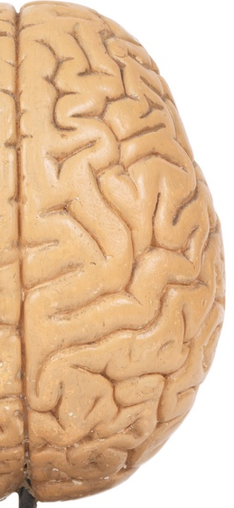
Your brain Your body
Neurons:
85 billion 500 million
85,000,000,000
Neurotransmitters
identified:
> 100 > 40
500,000,000
Dopamine production:
50% 50%
Serotonin production
5% 95%
Source: New Scientist & neuroscience
stuff.tumblr.com
Both affect blood flow
Notes:
http://neurosciencestuff.tumblr.com/post/38271759345/gut-instincts-the-secrets-of-your-second-brain
(8byaku 5-ju oku. Body, 5 oku

Slide 24
Body clocks
Get up / weekdays?
Get up/ weekends?
Wish you could get up / every day?

Slide 25
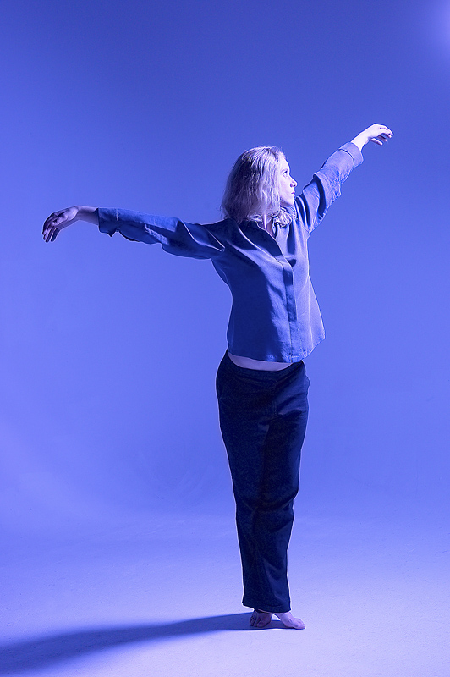
Body clocks
12
9 3
6
Get up / weekdays?
Get up / weekends?
Wish you could get up / every day?
Notes:
Ten after ten
9:00
7:45. I encourage Ss to use “a quarter to”/ a quarter after, etc.

Slide 26
What time did you
12
9 3
6
…get up today?
…go to bed last night?
…get up last Sunday?
4. …leave for school?
5. …get to school?
6. …work or do homework? x:xx to x:xx
7. …eat dinner.
8. …wish you could get up every day?
.
Notes:
26

Slide 27
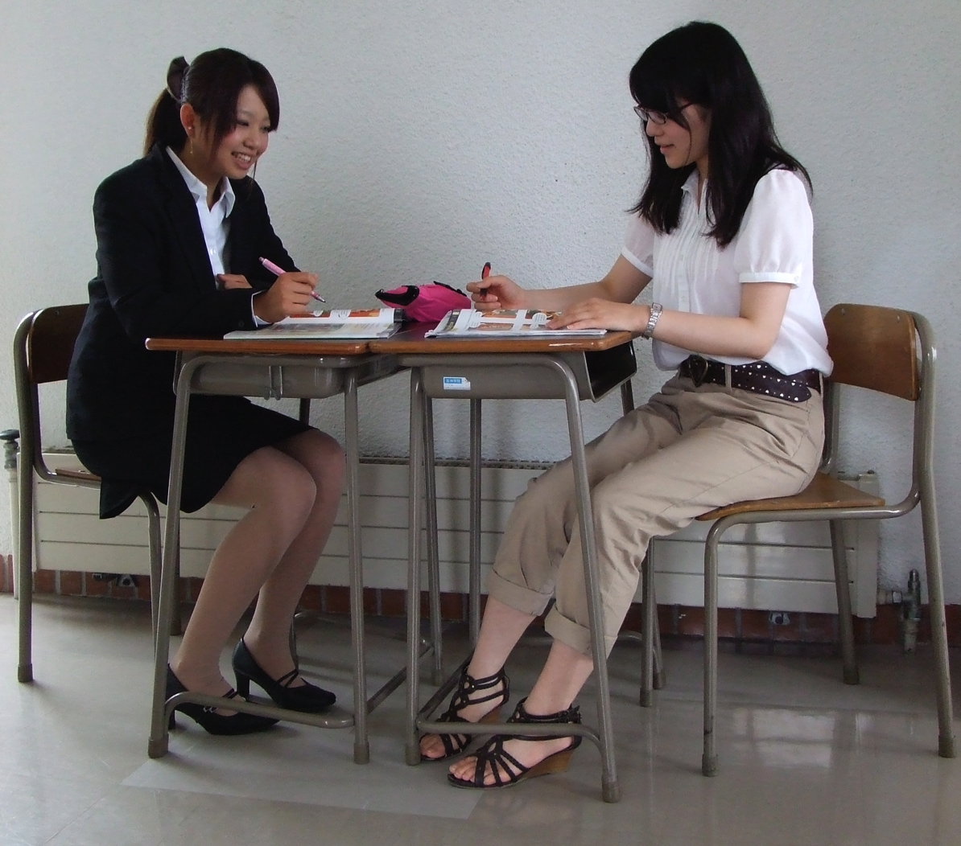
S20
How long
do your
students
sit in
class?
20
minutes
Blood
build-up

Slide 28
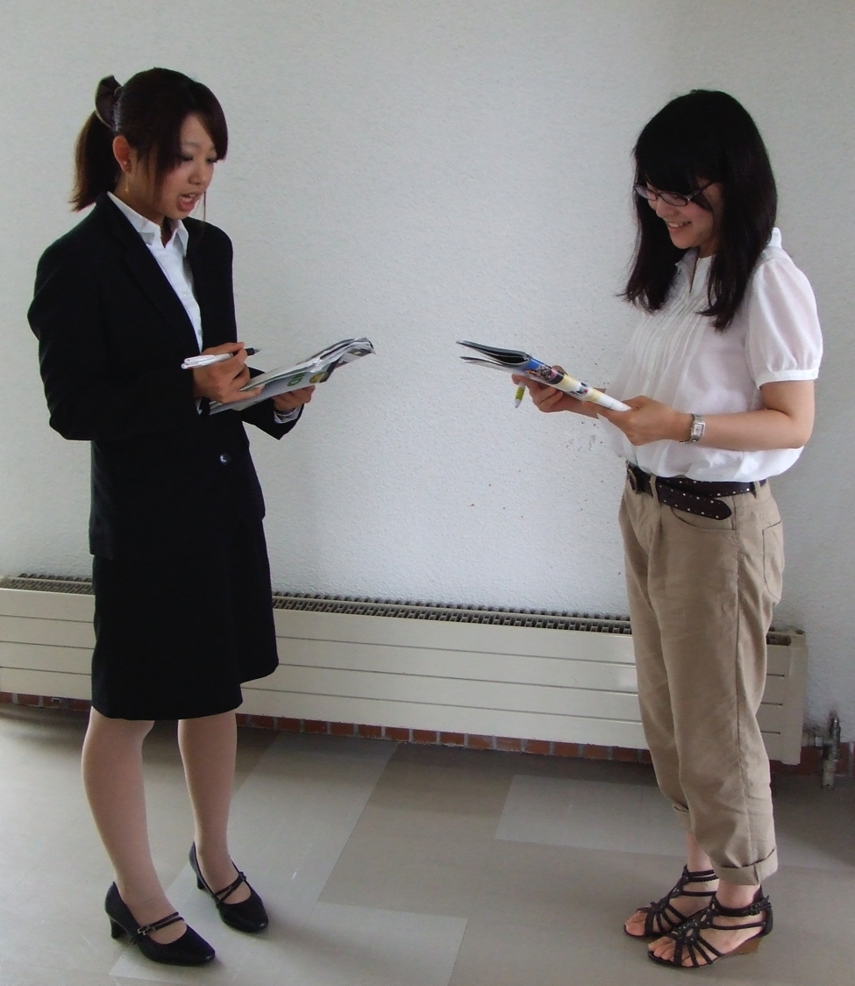
1 minute
+ 15%

Slide 29
Why physical?

Slide 30
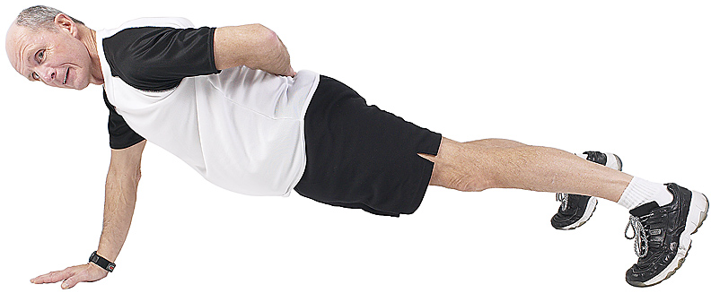
Why physical?

Slide 31
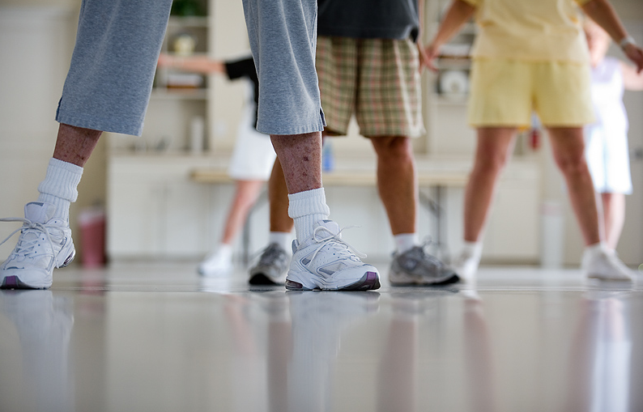
Moving together,
we connect:
Motor
Empathy
Rapport
Notes:
Goong-meen cheh-joe People’s calisthenics

Slide 32
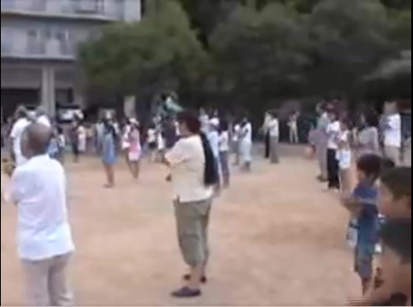
Notes:
Goong-meen cheh-joe people’s calisthenics.
Sometimes, (I’ve seen this especially in group cultures), they come up with interesting ways to get people moving together.

Slide 33
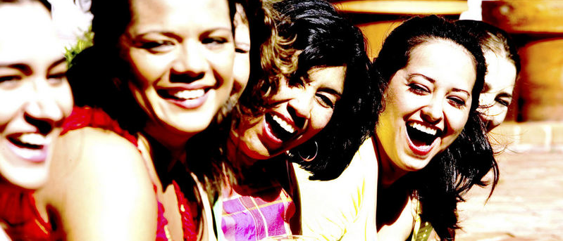
Line up nonverbally
Notes:
Height Nonverbal communication is Communication
- birthday (Jan – December) - need to speak to check
- time you got up today. (drop if no time)
- How long it took you to get here today
-

Slide 34
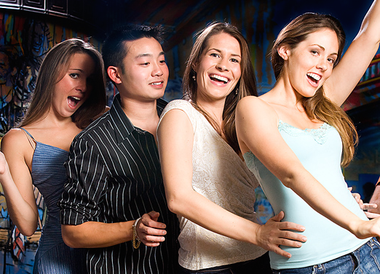
Make groups of 4-6.
How fast can you
line up each way?
No speaking.
Gestures are OK.

Slide 35
No speaking.
Gestures are OK.
No speaking.
Gestures are OK.

Slide 36
When you finish…
sit down.
Check by speaking.

Slide 37
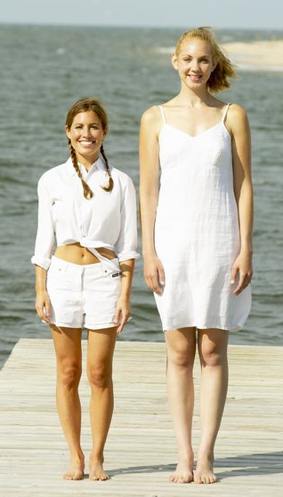
Line up by…
height.
Shortest to tallest.
Check by
speaking.

Slide 38
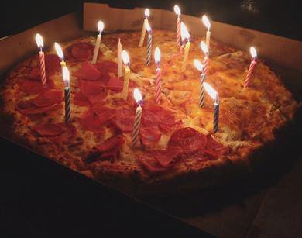
Line up by…
birthdays.
January
to December
Check by
speaking.

Slide 39

Line up by…
how long
it took to get to
school today.
Shortest time to
longest.
Check by
speaking.

Slide 40
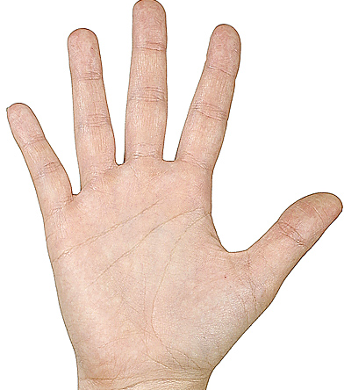
Line up by…
the size of
your hand.
Smallest to biggest
Compare.

Slide 41
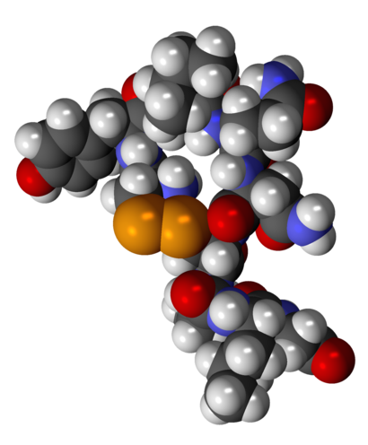
Appropriate, wanted
touching releases
oxytocin. It is related
to bonding, increasing trust
and reducing fear.
Source: http://psychcentral.com/
lib/about-oxytocin/0001386
Notes:
How does she look? (worried, nervous)
#2 - relaxed.

Slide 42

www.tinyurl.com/ELTphysical
Energy break

Slide 43
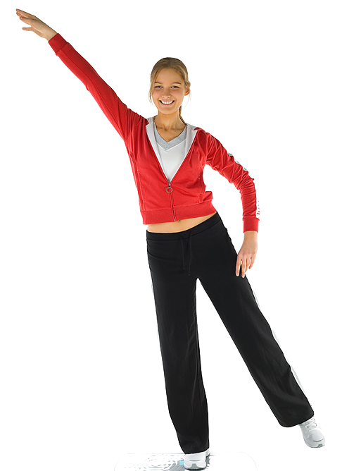
5
right here,
right now.

Slide 44
What are 5
exercises you
could do right
here,
right now?

Slide 45
Your
ideas:

Slide 46
Here are
some more.

Slide 47
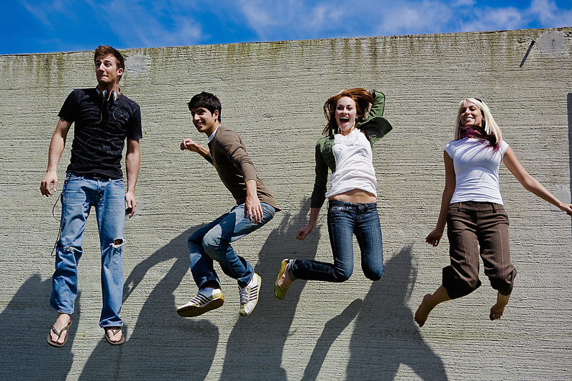
jumping

Slide 48
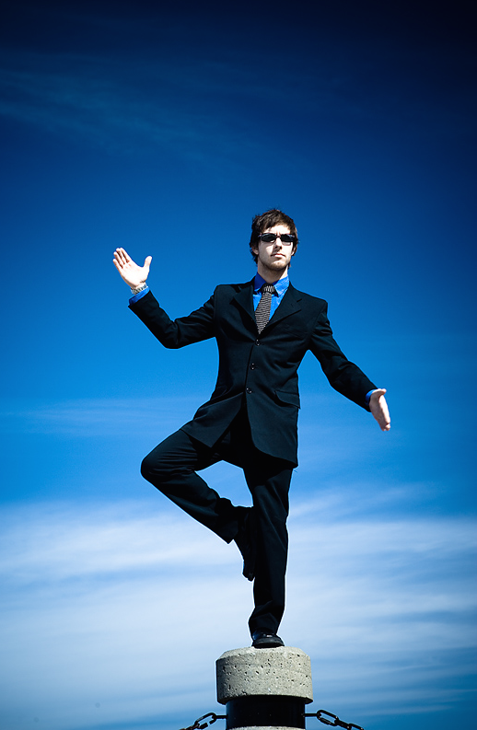
balancing

Slide 49
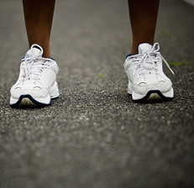
running
in place

Slide 50
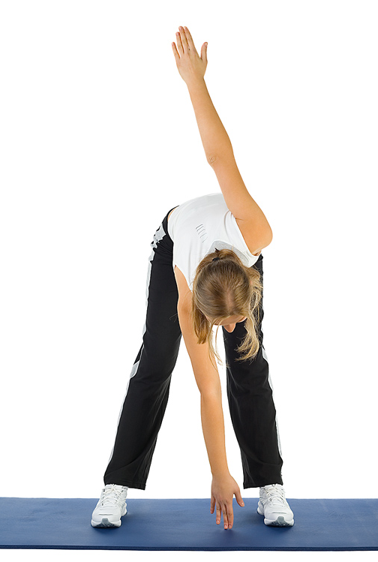
touching
your
toes

Slide 51
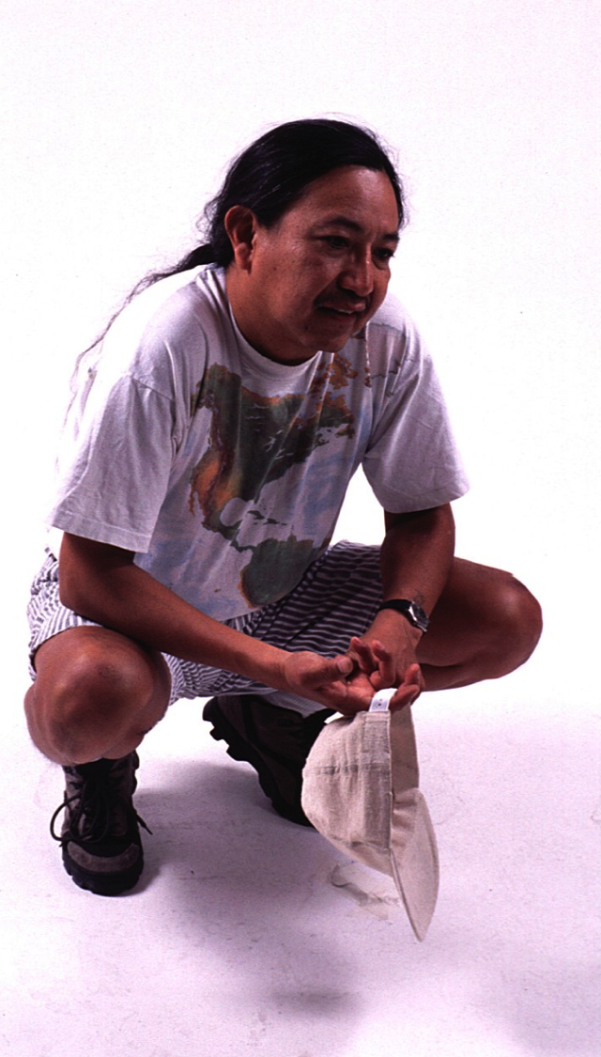
doing
squats

Slide 52
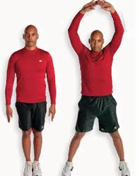
jumping
jacks
Courtesy pixshark

Slide 53
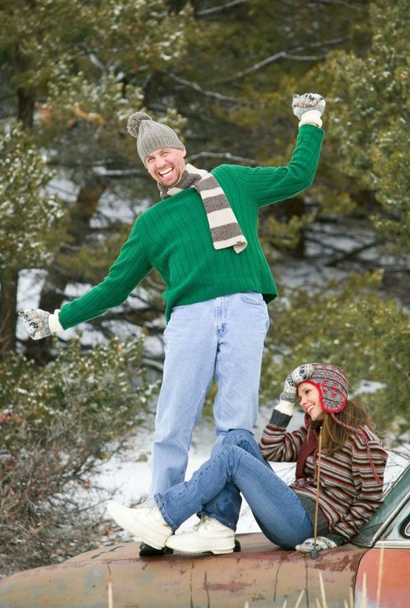
stretching

Slide 54
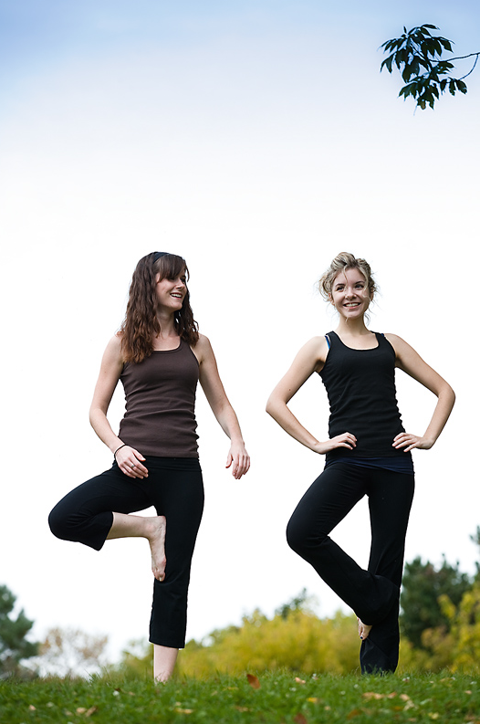
Work with
a partner.
Do an
exercise.
Partner,
match it.

Slide 55
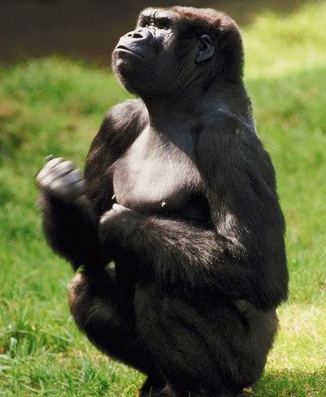
Partner, when you
want to change…

Slide 56
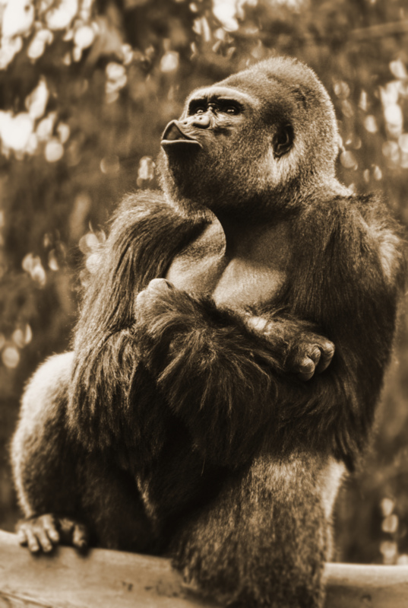
make an
“ X “ with
your arms.
You start
the next
one.

Slide 57
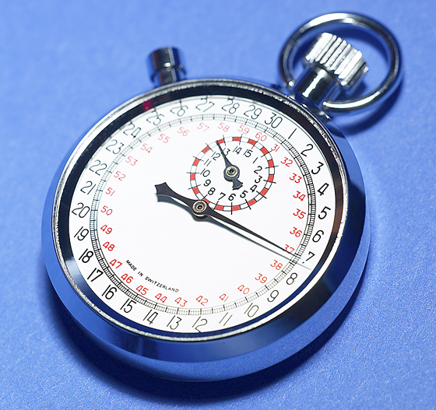
Do this for
1 minute.

Slide 58
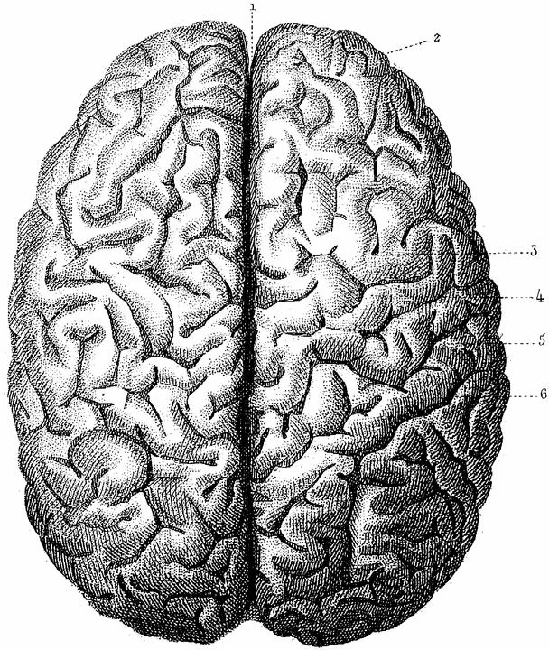
Notes:
Brain – 2 hemispheres. Different responsibilities.
NOT 2 brains. Work together. If every had a boss with half a brain, you know what I mean.
.

Slide 59
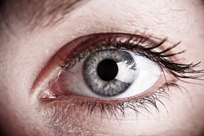
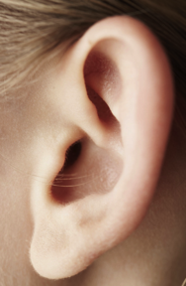
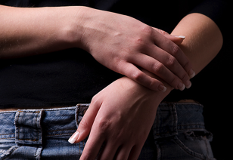
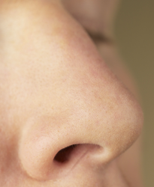
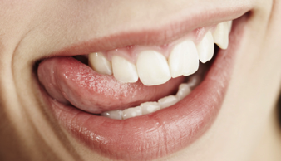
The senses
Visual sight
Auditory hearing
Haptic (tactile+kinethetic)
touch/feeling
Olfactory smell
Gustatory taste

Slide 60
The senses
Visual
Auditory
Haptic
Olfactory
Gustatory
Notes:
Visual learners – praise: You are always paying attention.
Auditory learners – praise: You always listen carefully.
Haptic (kinesthetic) learners – punished. Sit STILL.

Slide 61
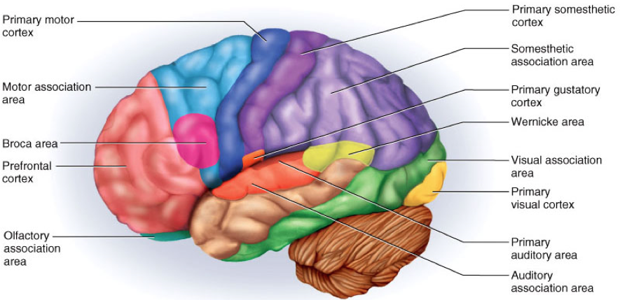
motor
association
area
somatosensory
motor (movement)
Somatosensory
association area
auditory
gustatory
auditory association
visual
visual association area
olfactory
Notes:
. Somatosensory (somasthetic) cortex – touch,position in space, balance, , also temperature, sensitivity, pain, maybe magnetic, etc
----- Meeting Notes (10/31/15 11:58) -----
Multi-sensory: learn better.
Pix of Justin Timberlake -- triggers visual cortex
video of him singing - trigger visual and auditory
signing and dancing - triggers visual, auditory, motor, maybe somato sensory. Imagine of Justin Beiber - gag reflex.

Slide 62


motor
association
area
somatosensory
motor (movement)
Somatosensory
association area
auditory
gustatory
auditory association
visual
visual association area
olfactory
Metaphor credit:
Curtis Kelly
Joke credit: Marc
Notes:
. Somatosensory (somasthetic) cortext – touch,position in space, balance, , also temperature, sensitivity, pain, maybe magnetic, etc
----- Meeting Notes (10/31/15 11:58) -----
Multi-sensory: learn better.
Pix of Justin Timberlake -- triggers visual cortex
video of him singing - trigger visual and auditory
signing and dancing - triggers visual, auditory, motor, maybe somato sensory. Imagine of Justin Beiber - gag reflex.

Slide 63

Multi-sensory
input:
All groups:
greater recall
- John Medina
Brain Rules

Slide 64
Multi-sensory
input:
50-75% more creative problem solving
- John Medina
Brain Rules

Slide 65
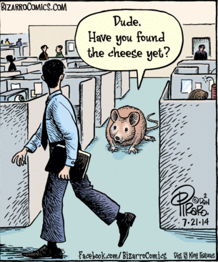

Lab rats –
Aerobic
exercise,
learn
mazes
2 – 12 x
faster
http://depts.washington.edu/adrcweb/BuchnerPresentation061307.pdf

Slide 66
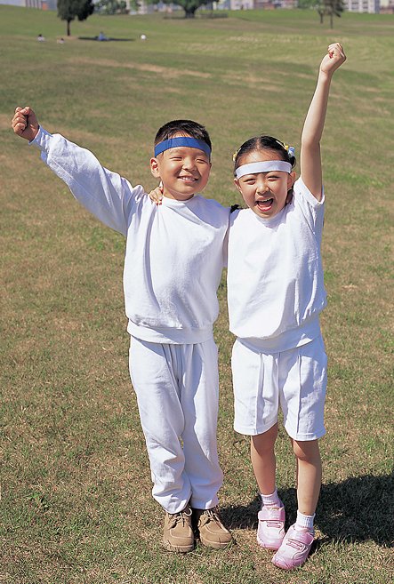
Schools
with PE
classes,
students
better on
science &
math tests.
Notes:
Spark. John Ratey

Slide 67
After
exercise,
20% faster
learning
vocabulary.
2007 German study, cited in: High impact running improves learning B. Winter, et al
Neurobiology of Learning and Memory 87 (2007) 597–609
Notes:
High impact running improves learning B. Winter, et al
Neurobiology of Learning and Memory 87 (2007) 597–609
www.elsevier.com/locate/ynlme
Bernward Winter a,¤,1, Caterina Breitenstein a,b,1, Frank C. Mooren c, Klaus Voelker d, Manfred Fobker e, Anja Lechtermann d, Karsten Krueger c, Albert Fromme d, Catharina Korsukewitz a, Agnes Floel a, Stefan Knecht
2007 German study, cited in:
http://time.com/12086/how-to-make-your-kids-smarter-10-steps-backed-by-science/

Slide 68
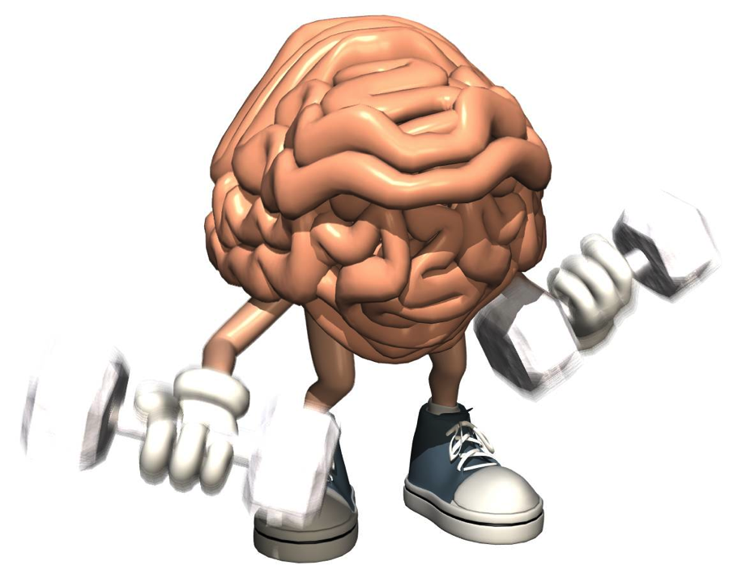
Exercise increases BDNF
Brain-derived neurotrophic factor
“Miracle-Gro
For the Brain”
- John Ratey
Harvard
Notes:
Protein – biological link between thought, emotion and movement.
Increases voltage in brain.
Brain Derived Neurotrophic Function

Slide 69

Why exercise helps memory?
cathepsin B
Muscles
produce
during exercise
Increased cells & connections in hippocampus
Notes:
CaTHEPsin B PROTEIN (maybe – new research. Maybe not whole answer)
http://www.cell.com/cell-metabolism/fulltext/S1550-4131(16)30247-9
NPR story: http://www.npr.org/sections/health-shots/2016/06/23/483245084/a-protein-that-moves-from-muscle-to-brain-may-tie-exercise-to-memory

Slide 70

Why physical?
Notes:
English really is different that other subjects at school.
When warm-up. Music, sports, Classes that you DO, not just remember

Slide 71

Classroom
management
Notes:
Metaphors for teacher: facilitation, coach, etc. I like conductor (They make the music/do the work, we organize it.
Getting Ss thinking in same direction, paying attention. Part of that. Also, classroom logistics, late Ss, etc.

Slide 72

Why
Not?
Notes:
These activities are fun

Slide 73
Activate
Interest
Engage
Notes:
These Activate learning ,increase interest and engage the students
Engaged students learn more.

Slide 74


ABC travel
Notes:
Denmark, Egypt, ete. (going to future)

Slide 75

ABC travel
We’re going to go Alaska,
Then we’re going
to go to Bagio.
We’re going to go to Bagio,
Then we’re going
to go Cebu
Notes:
Denmark, Egypt, ete. (going to future)

Slide 76
ABC picnic
If you bring the apples,
I’ll bring the bananas.
If you bring the bananas,
I’ll bring the cake.
If you bring the cake.

Slide 77



ABC nouns
You have an album.
I have a book.
You have a book.
I have a cat.
You have a cat.,t.
Notes:
Denmark, Egypt, etc. (going to future)

Slide 78

Yogic
breathing
Insert video
in through
the nose
out though mouth
out though the mouth
Notes:
Pairwork, then teach other pair

Slide 79
Yogic
breathing
Insert video
OUT - 2-3-4-5-6
Hold - 2-3-4-5
IN - 2-3-4
out though mouth
Hold - 2-3-4-5
Notes:
Pairwork, then teach other pair

Slide 80


Slide 81
Things “good English
learners” say to themselves. Rost 2005
Learning English
makes me feel good.

Slide 82
Things “good English
learners” say to themselves. Rost 2005
Learning English
is my passion.

Slide 83
Things “good English
learners” say to themselves. Rost 2005
I believe
I’m a good student.

Slide 84
Things “good English
learners” say to themselves. Rost 2005
I’m hungry
for English.

Slide 85
Choose one you like.
Learning English
makes me feel good.
Learning English
is my passion.
I believe I’m a good student.
I’m hungry for English.

Slide 86
Choose one you like.
Teaching English
makes me feel good.
Teaching English
is my passion.
I believe I’m a good teacher.
I’m hungry for good teaching.

Slide 87

OK, this next
activity is a
little strange.
Mind
massage

Slide 88

Positive
peer neck
massage
Notes:
Make circles before click

Slide 89
Make a circle or line of 8-10.
Teaching English…
Massage your
partner’s neck
& shoulders.
Repeat your
sentence
many times.
Notes:
Make circles before click

Slide 90

Positive peer
neck massage

Slide 91
Sorta like this

Slide 92
…hungry for good teaching ..
I believe..
Sorta like this
Teaching English is..
…my passion..
…feels good.ß

Slide 93
Partner,
ENJOY.
Learning English…
J
Notes:
Make circles before click

Slide 94
Choose one you like.
Teaching English
makes me feel good.
Teaching English
is my passion.
I believe I’m a good teacher.
I’m hungry for good teaching.

Slide 95


Interesting fact:
Relaxed people
do up to 25%
better on tests.
Jensen, 2008
Notes:
How does she look? (worried, nervous)
#2 - relaxed.

Slide 96
Appropriate, wanted
touching releases
oxytocin. It is related
to bonding, increasing trust
and reducing fear.
Source: http://psychcentral.com/
lib/about-oxytocin/0001386
Notes:
How does she look? (worried, nervous)
#2 - relaxed.

Slide 97
After
exercise,
20% faster
learning
vocabulary.
2007 German study, cited in: High impact running improves learning B. Winter, et al
Neurobiology of Learning and Memory 87 (2007) 597–609
Notes:
High impact running improves learning B. Winter, et al
Neurobiology of Learning and Memory 87 (2007) 597–609
www.elsevier.com/locate/ynlme
Bernward Winter a,¤,1, Caterina Breitenstein a,b,1, Frank C. Mooren c, Klaus Voelker d, Manfred Fobker e, Anja Lechtermann d, Karsten Krueger c, Albert Fromme d, Catharina Korsukewitz a, Agnes Floel a, Stefan Knecht
2007 German study, cited in:
http://time.com/12086/how-to-make-your-kids-smarter-10-steps-backed-by-science/

Slide 98


Wendy Suzuki, PhD
Neuroscientist
New York
University

Slide 99

Single workout:
Increases reaction time
Increases dopamine,
serotonin,
noradrenaline (+mood)
Increases ability to shift,
focus attention.

Slide 100

Long-term:
Increases attention
& + mood
Increases volume of
brain cells in hippocampus
(memory)
serotonin,
Noradrenaline
Protects brain (hippocampus,
PFC) from aging
Notes:
3-4 times a week. 30 min. Includes aerobic

Slide 102

https://www.ted.com/talks/wendy_suzuki_the_brain_changing_benefits_of_exercise
From 11:15
Notes:
11:41

Slide 103
Throughline
Reasons & ways we can & should use physical activities
in our classes

Slide 104

How come
grown-ups don’t
go out to play?

Slide 105

Grown-ups can only justify playing outside
by calling it exercise,
doing it
when they’d rather not.

Slide 106

Except you
don’t get paid.
That sounds
like a job

Slide 107

So play is
worse than
work?
Being a
grown-up is
tough.

Slide 108

We doinWE
We don’t stop playing
because we grow old.

Slide 109
We doinWE
We grow old because we stop playing.

Slide 110
Let’s get physical
Thank you!
I hope you were moved
Notes:
2 contrast ideas:
Stand 4-5 meters away from computer. Can you read it (contrast plus font)
Print out and photocopy in black and white)

Slide 111

Thanks to you for playing.

