Slide 1
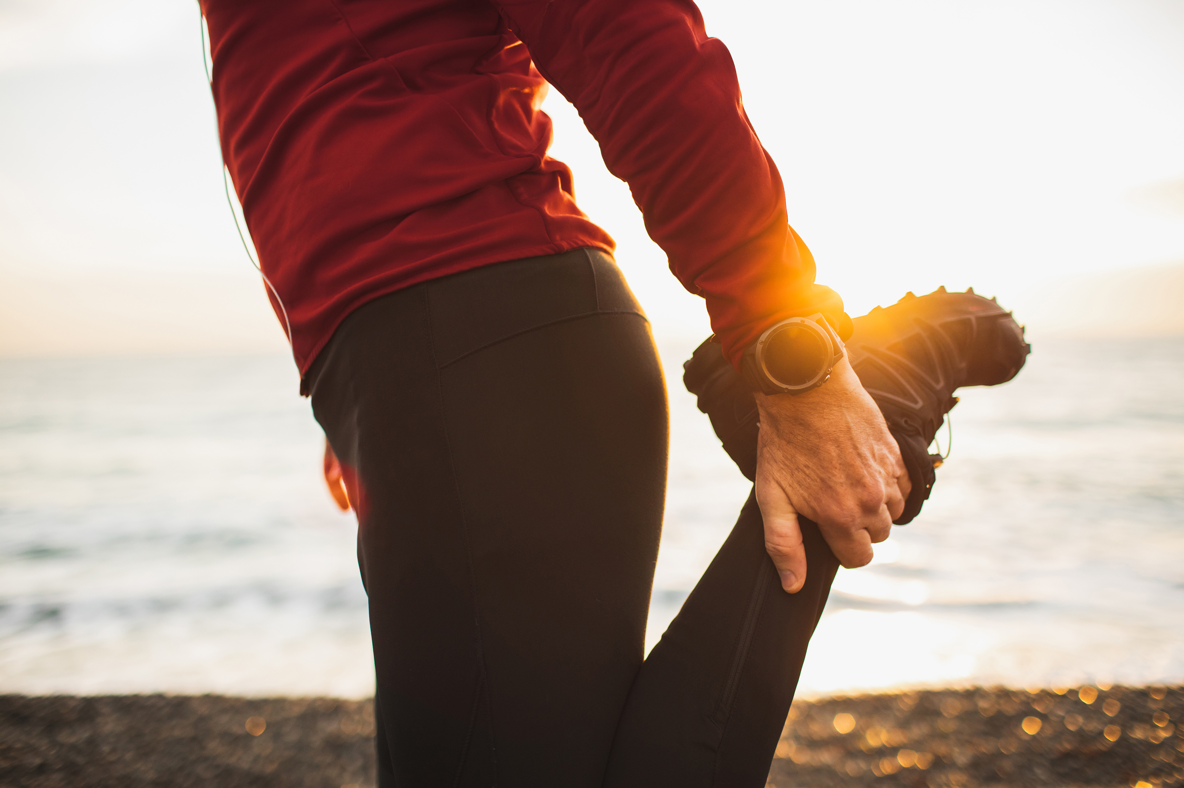
Energy break part 1
Stand up.
Bend your knee and grab your foot.
Do the same with the other leg
Each time is 15 seconds.

Slide 2
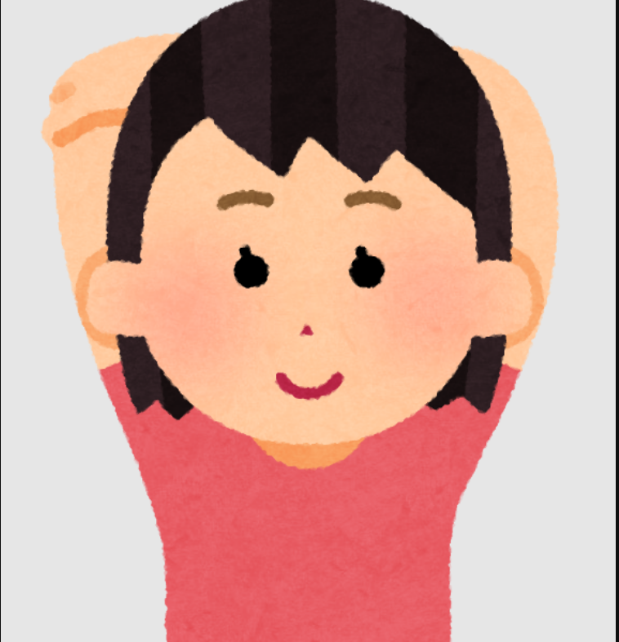
Energy break part 2
1.Stand up.
2.Bend your elbows and put your hands behind your head.
3.Grab each bent elbow with the other hand.
4.Keep this pose for 15 seconds.
5.Also do opposite.

Slide 3
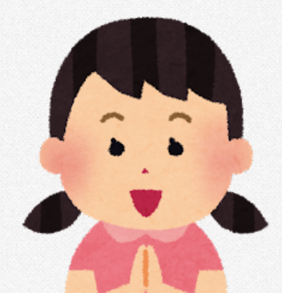
Energy break part 3
1. Stand up.
2. Put your hands together.
3. Lower your arms and extend your wrists.
4. Keep doing this for one minute.

