Slide 1
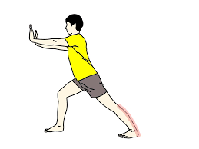
Energy Break
1. Stand up
2. Stretch out your arms and lean against the wall.
3. Bend one knee.
4. Stretch the other leg behind you.
5. Keep this pose for 20 seconds.
6. Do the same by changing your left and right legs.
7. Sit down.
Shinzato Mai

