Slide 1
Energy Break
Stand up.
Keep a distance so as not to hit other people.
Imitate the pose in the image.
Keep each pose for ten seconds.
Sit down.

Slide 2
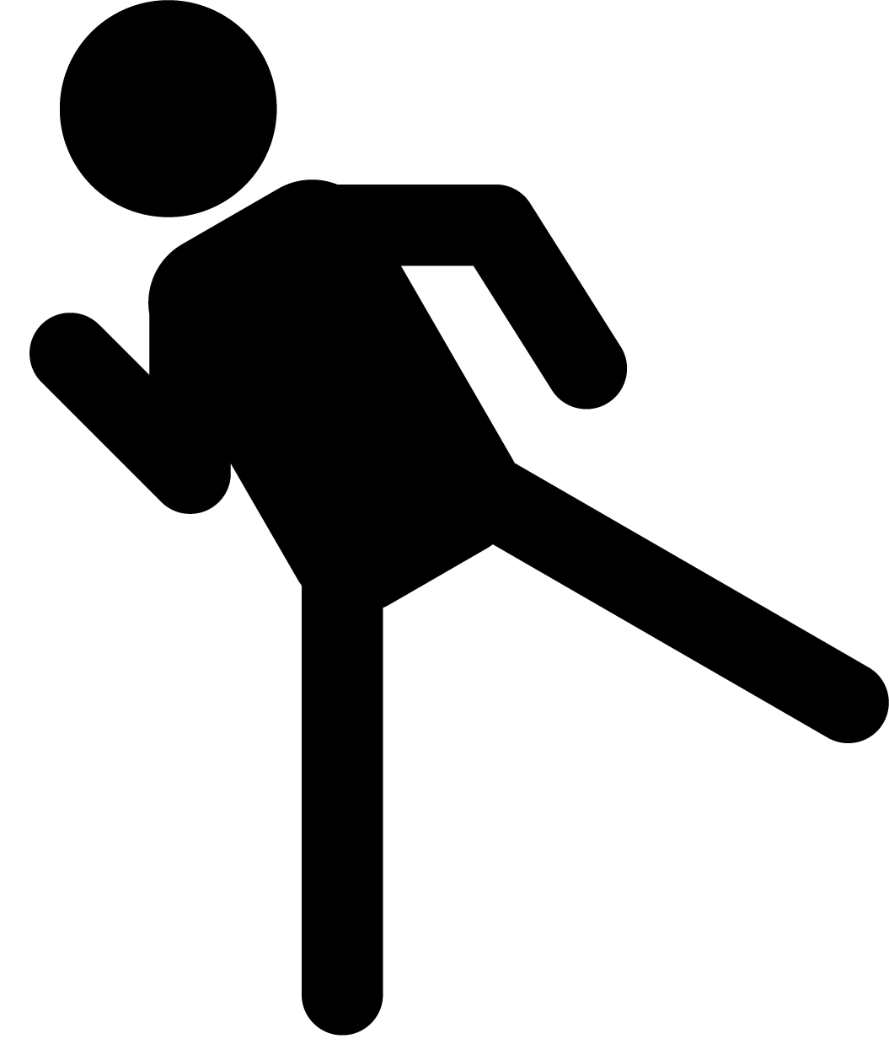
1
2

Slide 3
3
4

