Slide 1
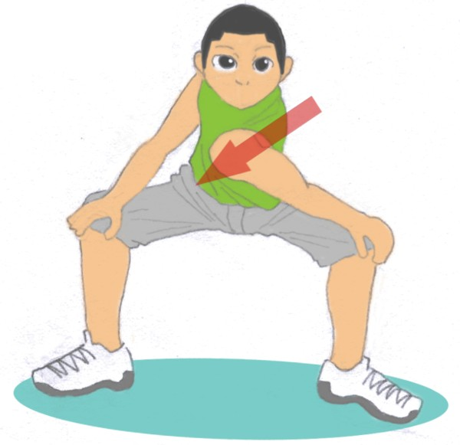
Energy break
1.Stand up
2.Open both your legs
3.Put your hands on both knees
4.Swing your shoulders
5.Repeat, alternating left and right

