Slide 1
Energy breaks
Human beings were not designed to sit in desks all day. Energy breaks are a series of short, physical activities you can use to get your students moving and energized.
This song is based on the “loving kindness” meditation.
It is also know as metta meditation.
It grew out of a Buddhist tradition but this version is
not religious.
References are on the last slide.
The video is from YouTube. Betsy Rose, the singer, and SmileCalm
own it.
PowerPoint © Marc Helgesen. May be freely used for non-commercial purposes.
For more, visit: www.HelgesenHandouts.weebly.com. Click on “Physical activity…”
This slide is for the teacher’s information. The student slide show starts with slide 2.

Slide 2
Energy break

Slide 3
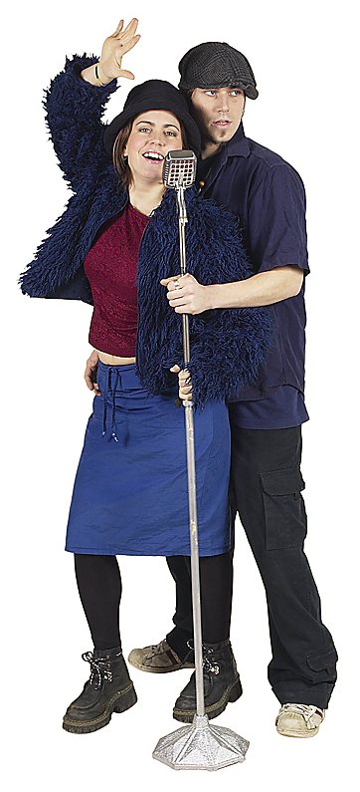
Let’s
Sing!
May you be happy,
peaceful and loved.

Slide 4
The words of this song come
from a very old meditation.
It is called the
“loving kindness meditation.”

Slide 5
The singer/ meditator wants these things
for him/herself,
others &
everyone.

Slide 6
May I be happy.

Slide 7
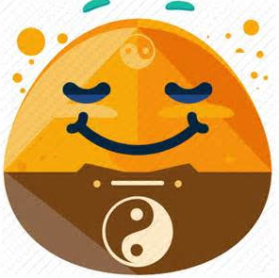
May I be peaceful.

Slide 8
May I be
filled with love.

Slide 9
Meditation
is good
for the
brain &
the body

Slide 10
Meditation
improves
thinking
& focus

Slide 11
Meditation
reduces stress

Slide 12
Meditation
improves heart health

Slide 13
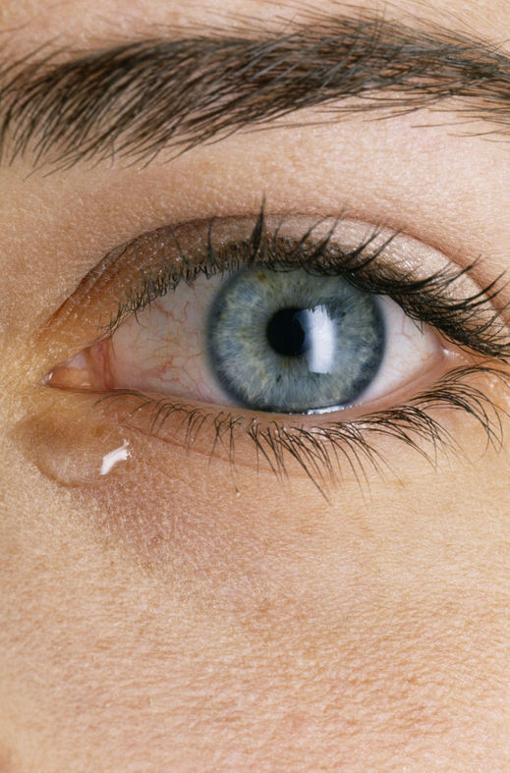
Meditation
reduces
pain
• physical
• emotional

Slide 14
Meditation
improves
relationships

Slide 15
With your partners,
think of gestures for:
May you be happy.
May you be peaceful.
May you be
filled with love.

Slide 16
Stand up.
Sing with the video
Use your gestures.
Point to yourself,
others,
Enjoy!
everyone.

Slide 18
I hope you are
happy,
peaceful
& loved.

Slide 19
Source:
Betsy Rose
May I be happy
https://www.youtube.com/watch?v=RU_Vj0kytFo

Slide 20
I learned about this video
from the University of Wisconsin-
Madison’s Center for Healthy Minds’
Kindness Curriculum
For links and EFL/ESL activities for
Mindfulness, visit:
https://www.eltandhappiness.com/mindfulness-for-kids.html
Betsy Rose
May I be happy
https://www.youtube.com/watch?v=RU_Vj0kytFo

Slide 21
References
Top 11 Health Benefits of Singing
https://www.healthfitnessrevolution.com/top-11-health-benefits-of-singing/
Improves brain function & attention span
Singing Or Playing An Instrument Improves Brain Function, Offsets Rich Kid/Poor Kid Academic Achievement Gap
https://www.medicaldaily.com/singing-or-playing-instrument-improves-brain-function-offsets-rich-kidpoor-kid-academic-297156
Singing is good exercise
builds stamina (energy level)
uses more oxygen
All together now: singing is good for your body and soul
https://www.telegraph.co.uk/news/health/10168914/All-together-now-singing-is-good-for-your-body-and-soul.html
Lowers stress naturally
4 Scientific Studies that Show Music Decreasing Stress and Promoting Healing
https://blogs.psychcentral.com/nlp/2015/04/5-scientific-studies-the-prove-music-decreases-stress-and-promotes-healing/
Builds memory and concentration
Singing for the Brain can help people with dementia to connect with the wider community
https://www.alzheimers.org.uk/get-support/publications-and-factsheets/dementia-together-magazine/singing-brain-can-help-people-dementia-connect-wider-community

Slide 22
Let’s move!

Slide 23
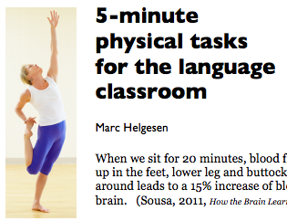
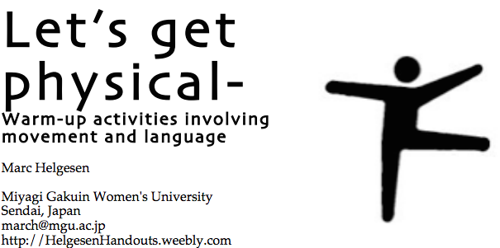
More ideas at
http://tinyurl.com/ELT-physical

