Slide 1
Energy breaks
Human beings were not designed to sit in desks all day. Energy breaks get your students moving and energized.
Line up nonverbally is a movement activity. Students, in groups of 6-8 (or whatever is convenient) line up in a series of different ways. They see how quickly they can do it. The lining up is nonverbal, then they check by speaking.
Note: there are 2 versions of this slide show Each introduces 5 tasks. This is number 2. The “brain byte” at the end (slides 12 & 13) reminds them of info from Line up nonverbally #1 and adds more information.
Use slides 12 and 13 to explain the importance of movement. One minute of movement increases blood/oxygen to the brain by 15%
© Marc Helgesen. May be freely used for non-commercial purposes.
For more, visit: www.HelgesenHandouts.weebly.com. Click on “Physical activity…”
This slide is for the teacher’s information. The student slide show starts with slide 2.

Slide 2

Energy break

Slide 3

Line up nonverbally #2
Notes:
Height Nonverbal communication is Communication
- birthday (Jan – December) - need to speak to check
- time you got up today. (drop if no time)
- How long it took you to get here today
-

Slide 4

Make groups of 6-8.
How fast can you
line up each way?
No speaking.
Gestures are OK.

Slide 5
No speaking.
Use gestures.
No speaking.
Gestures are OK.

Slide 6
When you finish…
sit down.
Check by speaking.

Slide 7
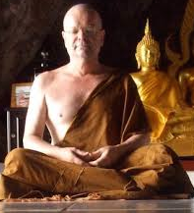

Line up by…
hair length.
Shortest to longest.
Does
everyone
agree?
Notes:
Just FYI, the person in the monk is Marc Helgesen, the authors of this slideshow and the website it is on. I had a wonder experience as a novice monk in Thailand a few years ago.

Slide 8

Line up by…
the time
you went
to bed
last night.
Earliest to latest.
Check by
speaking.

Slide 9

Line up by…
how long
it took to get to
school today.
Shortest time to
longest.
Check by
speaking.

Slide 10

Line up by…
time
on-line
each day.
Least to most.
Check by
speaking.

Slide 11
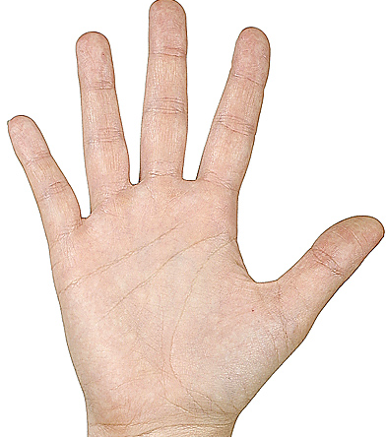
Line up by…
the size of
your hand.
Smallest to biggest
Compare.

Slide 12
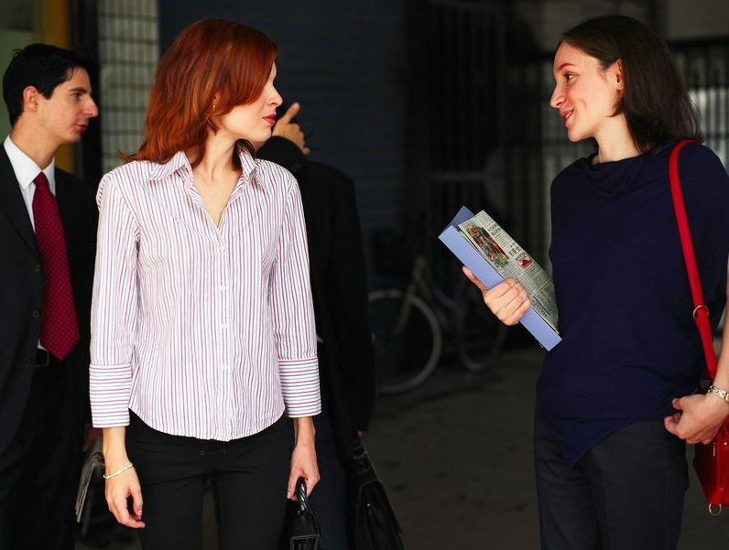
If you did
Line up nonverbally #1,
what does this slide mean?
Hint:

Slide 13
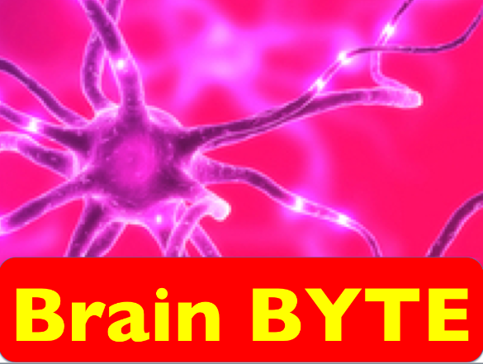
When you stand and move, it increases blood and oxygen
to your brain.
1 minute = +15%
Source: Sousa, D. (2011) How the Brain Learns, Thousand Oaks, CA: Corwin Press.

Slide 14
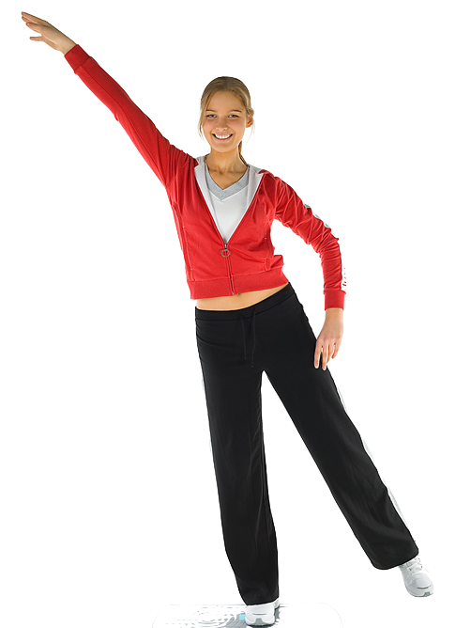
Let’s move!

Slide 15
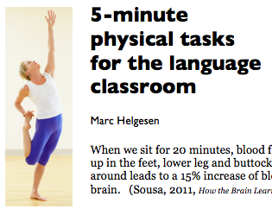
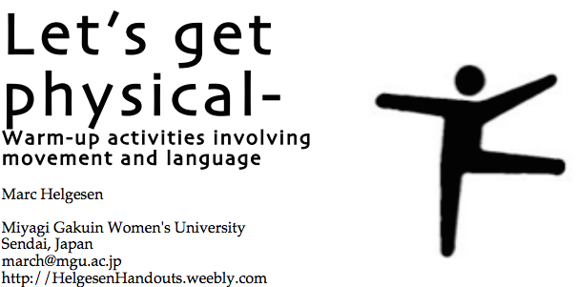
More ideas at
http://tinyurl.com/ELT-physical

